Slide 1
Individual Growth. Empowerment for all.

Slide 2
Our Purpose
Our purpose is to lead the way with best practice in education to enable Huntingdon pupils to aim high, overcome obstacles and achieve their goals. Our children deserve the very best and we will relentlessly pursue excellence for them.

Slide 3
Our vision
At Huntingdon Academy we believe in an enabling working environment which allows all of the school community to grow and be the best version of themselves; including pupils, staff, parents, governors - everyone.
To enable this to happen, we believe, that our values of listening, thinking, communication and collaboration should run through all aspects of school life, like a golden thread. Applying these values to our behaviours will enable people to have the ability and ambition to set themselves meaningful goals and have the resilience needed to overcome obstacles.
To understand how to communicate and collaborate with others enables people to be responsible members of society and be successful at work as well as in their personal life. We understand that all the school community should feel valued, know that they have an important contribution to make and feel empowered that their voice can make a difference.

Slide 4
Our mission
Pupils actively think and discuss topics and issues that impact on either themselves, their school or society
Teaching and Learning that empowers children and develops curious minds
A curriculum that develops the whole child and provides outstanding outcomes
A mentally healthy culture and climate in school where all stakeholders relentlessly pursue best practice
Quality professional development resulting in outstanding practitioners who are specialists in their field
Children are equipped with academic and emotional resilience to succeed

Slide 6
Contracting for CPD
We want to offer… | We Ask for…
Positive experience | Feedback/ Interaction/ honesty
Professionalism | Manners/ Mobile Phones
Knowledge/ Skills | Professionalism and application of learning
CPD which has an impact | Respect the environment
A Learning Culture/ ethos | Positivity

Slide 7
Ice breaker
Talk to someone in the room about your book.
What did you enjoy about it?
Why was it a memorable read?
On the edge of my seat.
Couldn’t put it down.
CHARACTERS
PLOT
THEME
EMOTIONAL
INTRIGUING
BREATHTAKING
I enjoyed this book because…..
When I read this book…….
I would urge you to read this because….
Notes:
A passionate reader will…

Slide 8
Aim- to have a clear picture and shared agreement about…..
- to
Guided reading
Independent reading
Passion for reading

Slide 9
Complete the sentence stem.
A passionate reader will…..
What will you notice about the way that they read
Reading habits
Thoughts/feelings about reading
What other skills will it facilitate.

Slide 10
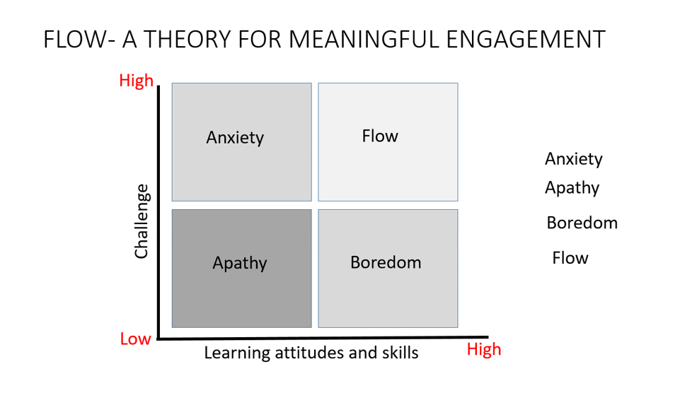
Everyone a reader
We need to help children enjoy books and see the reason behind putting effort into reading so they can see that it’s worth it!

Slide 11
Passion for reading

Slide 12
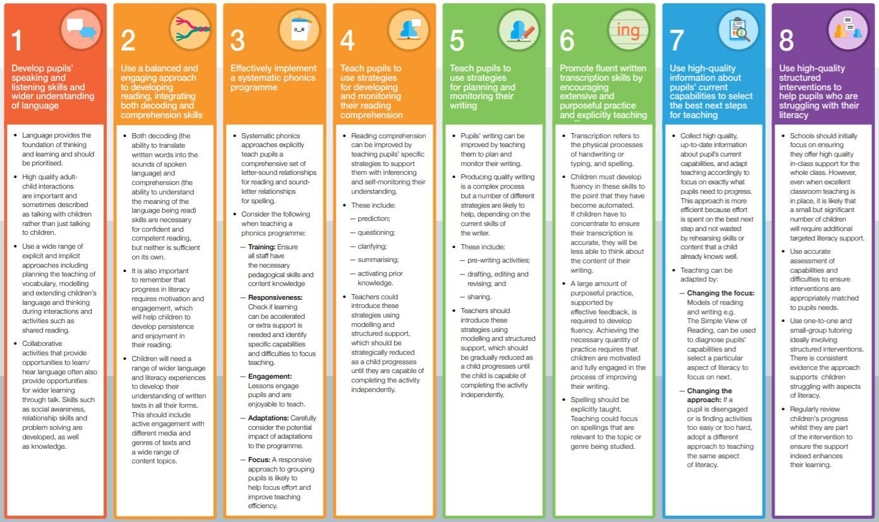
EEF supporting literacy –ks1
Insert slide about EEF notes.

Slide 13
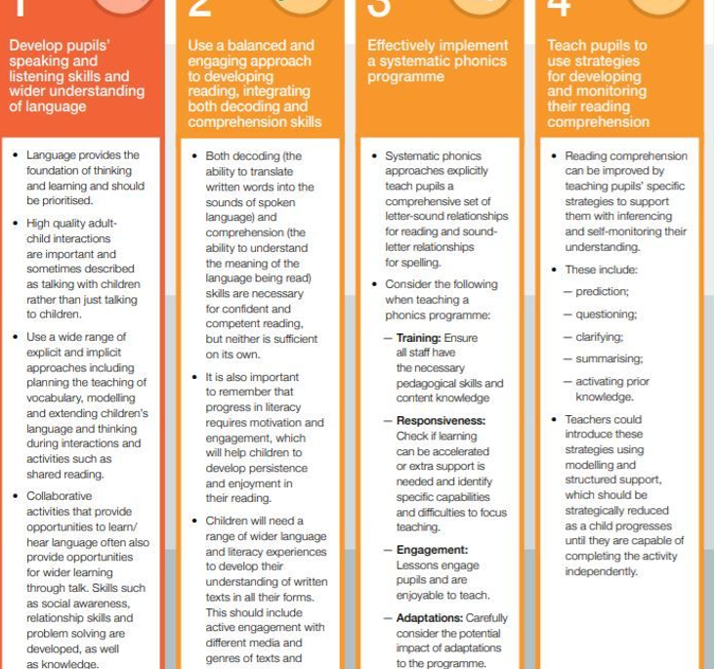

Slide 14
Learners who struggle to read well.

Slide 15
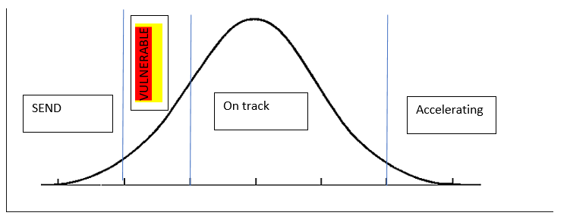
What are we doing for the struggling readers?
What implications does this have for our SEND and
vulnerable children?

Slide 16
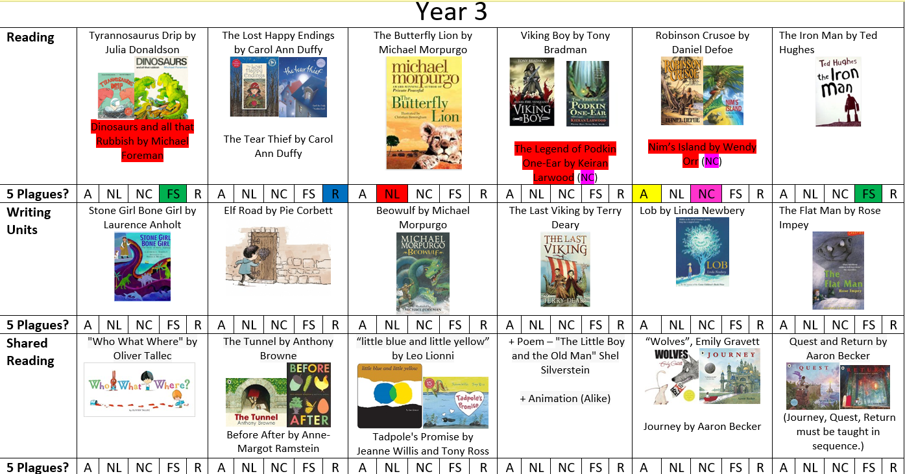
Reading Culture

Slide 17
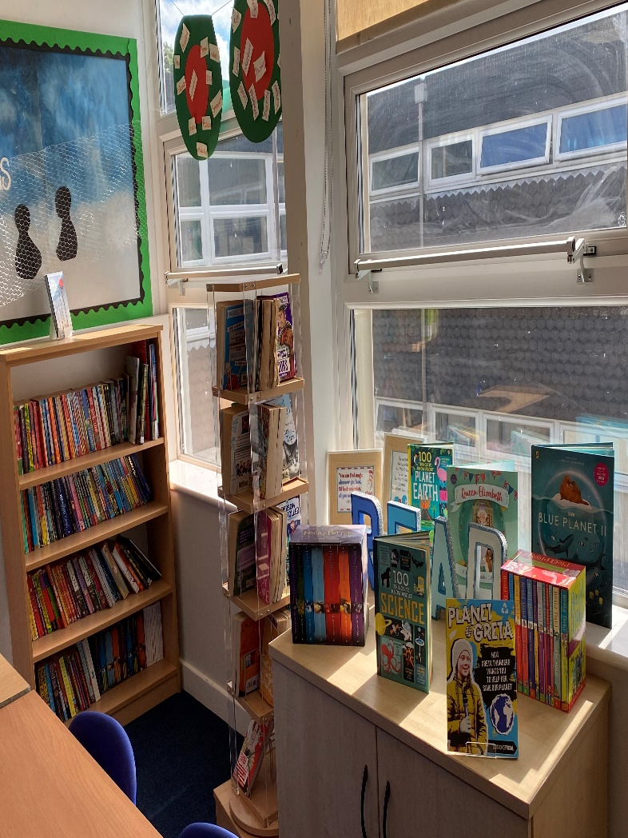
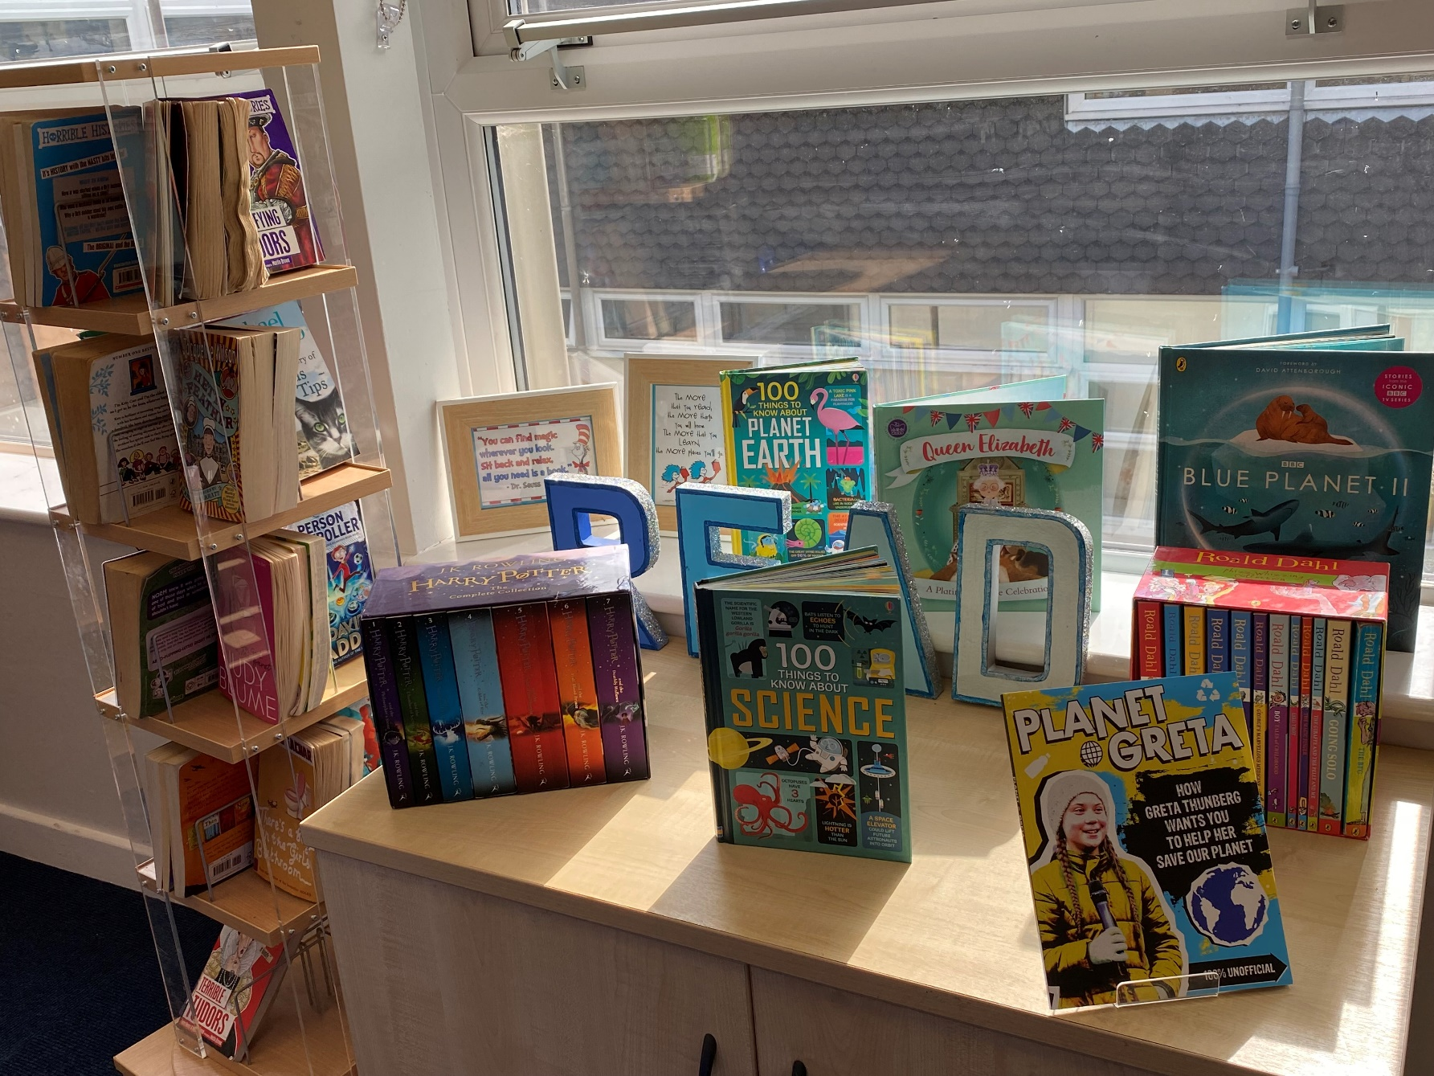
Reading culture
Interesting and well organised reading area. Topic related books are displayed. children are encouraged to keep it tidy..

Slide 18
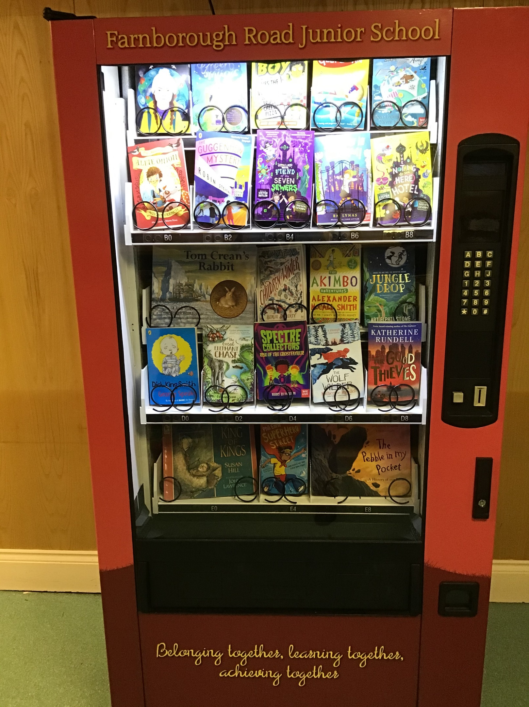
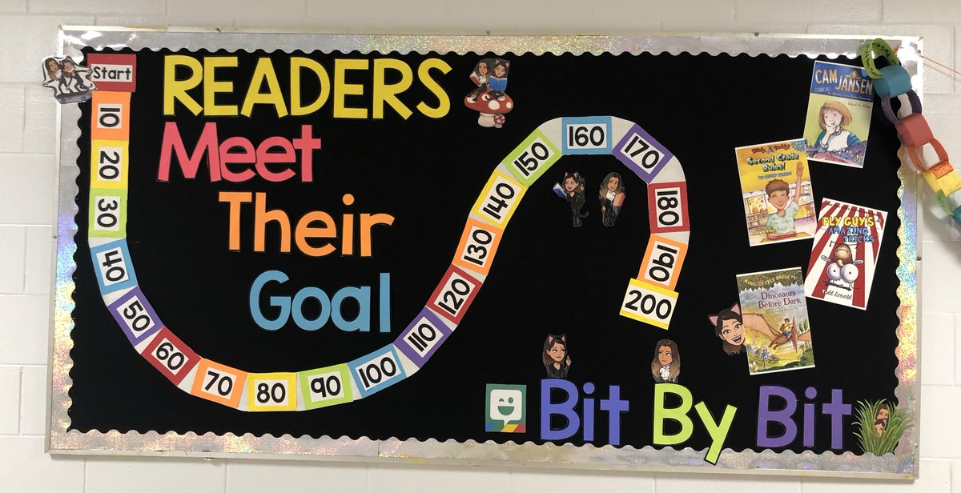
Reading culture
Notes:
How could this work now?
Introduce how will work.
How going to engange parents?

Slide 19
How do we create not just competent readers but children that LOVE READING?
Reading ethos and culture
Text selection
Comprehension
Reading for pleasure
Support for struggling readers
Modelling
Organisation of the teaching of reading

Slide 20
A successful guided reading session
What makes an effective guided reading session?
Use the POST Its to record your thinking.

Slide 21
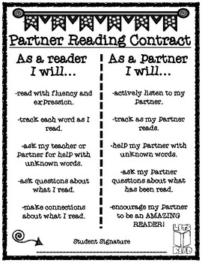
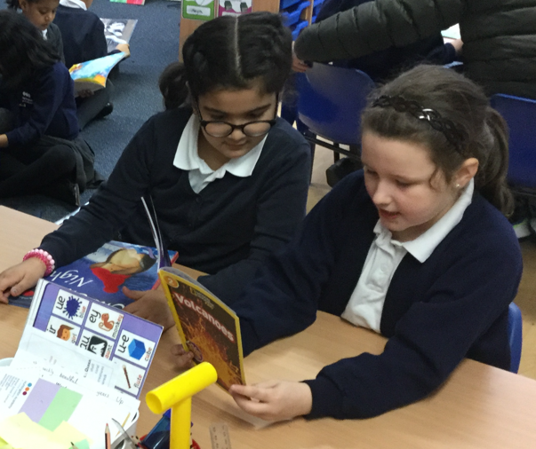
What are the benefits of paired reading?
How will you organise this? How will you quality assure?
.

Slide 22
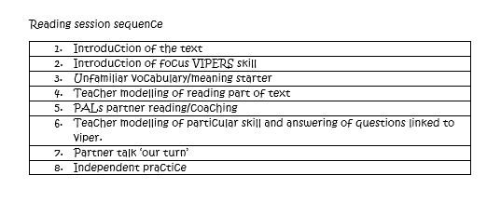
Reading session sequence
What might a guided reading session look like in your phase /year group?
These elements need to be present.
.

Slide 23
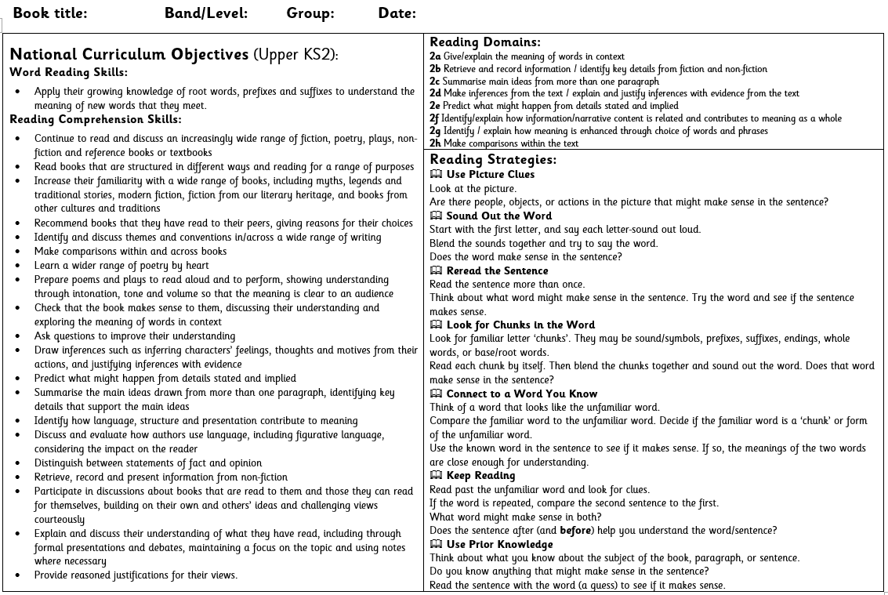
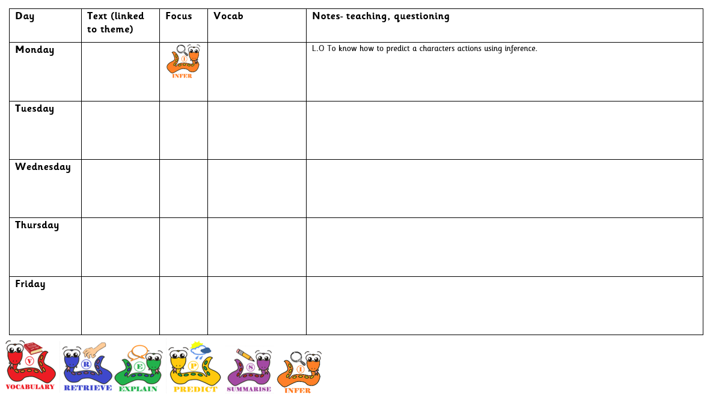
Guided Reading
Notes:
Spend time – teaching what good partner work looks like

Slide 24
Always, sometimes, never….
Texts used in GR are accurately pitched.
An intervention plan is in place for the 20% as well as the ‘struggling readers’.
All pupils have an accurately pitched reading book.
Guided Reading is taught daily and given high priority.
Learners are good at giving and receiving feedback.
All pupils can talk about the VIPERS and there progress in reading.
I model being a reader by reading a well chosen book to the class daily.
My environment strongly represents the importance of reading.

Slide 25
PITCH AND PLANNING
https://www.arbookfind.co.uk/default.aspx
How could we tell if a text was pitched accurately for a child?
What reading material is going home with the child in their reading folder?
Notes:
Talk about LEAD Values here

Slide 26
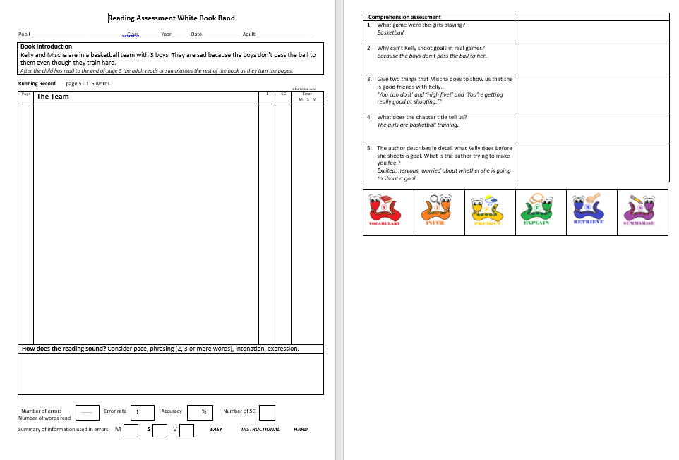
Miscue analysis and reading records
These must be completed for every child in assessment week.
Notes:
Talk about LEAD Values here

Slide 27
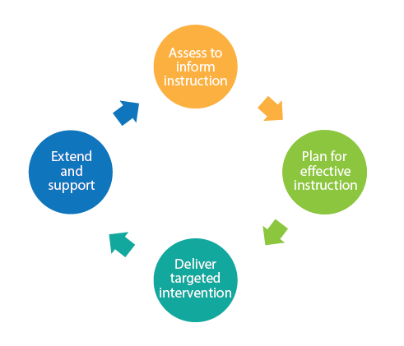
A quality session 1:1 reading
Reflect
How long do you spend with these 4 ideas in mind when delivering 121 reading?
How often do you model ARE reading strategies prior to them reading?
How do you know the child has made progress in that 121 session?
Notes:
Talk about LEAD Values here

Slide 28
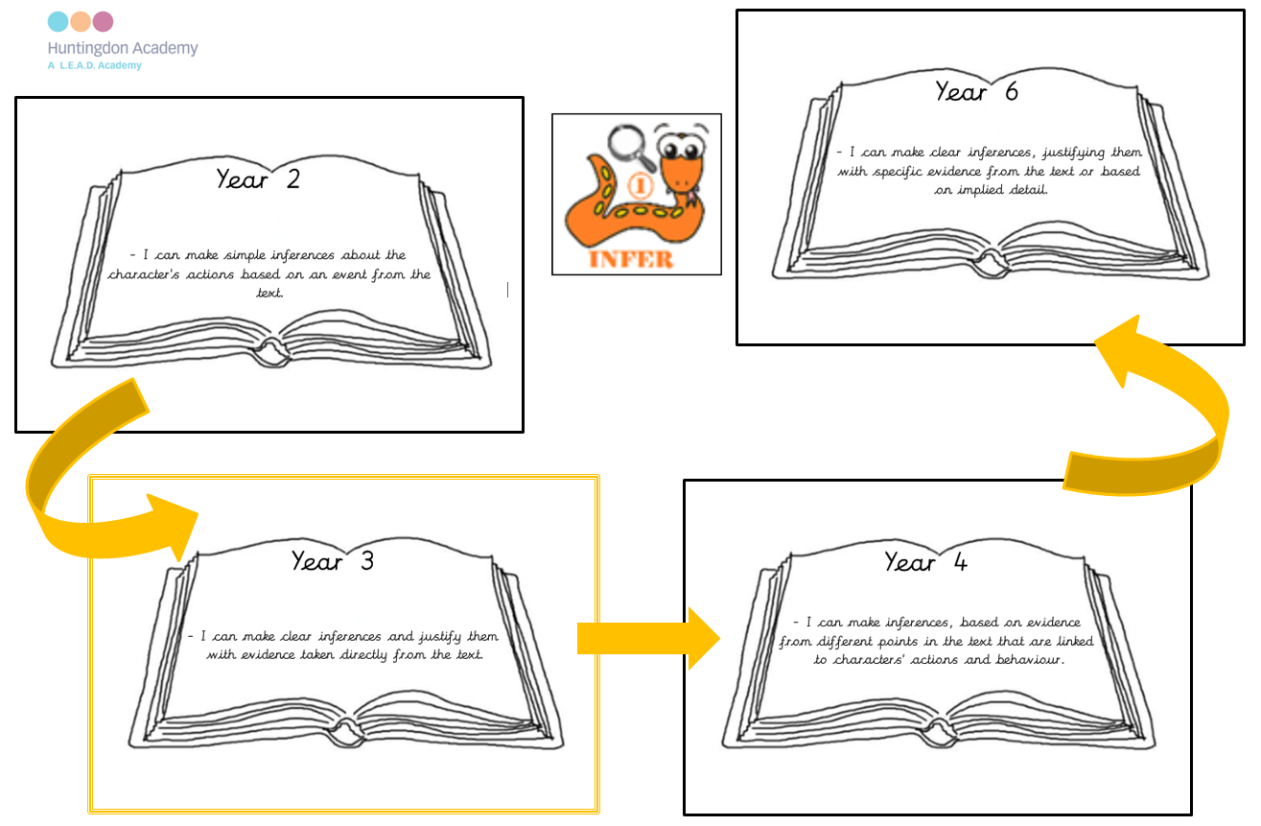
https://leadacademytrust.sharepoint.com/:w:/r/sites/HuntingdonAcademy/curriculum/_layouts/15/Doc.aspx?sourcedoc=%7BD70989DB-D340-4C33-8655-BCE66461BFCB%7D&file=Y3%20Inference.docx&action=default&mobileredirect=true

Slide 29
1 to 1 reading
To engage and motivate a child so that they are able to read a book with meaning and enjoyment we must;
Activate prior knowledge
Extend and clarify vocabulary
Discuss language structures
Model and support problem solving strategies
Identify areas of misconception

Slide 30
Parental Engagement
How can we continue to encourage children to read at home?
Do we know which children do not read aloud to an adult at home?
If children are not getting support at home, what are we doing about that in school?
Notes:
Talk about LEAD Values here

Slide 31
Reflection
- to
Where are you in each of these areas?
What will you do to ensure strong delivery in ALL of these areas?
Guided reading
Independent reading
Passion for reading

