Slide 1
Establishing a positive climate for learning
1.1 Learn that;
Teachers have the ability to affect and improve the wellbeing, motivation and behavior of their pupils
Learn how to;
create a culture of respect and trust in the classroom
Repond quickly to any behavior or bullying that threatens emtioanl safety
Reinforce routines
Notes:
How we manage our classrooms can have a significant impact on reducing misbehaviour

Slide 2
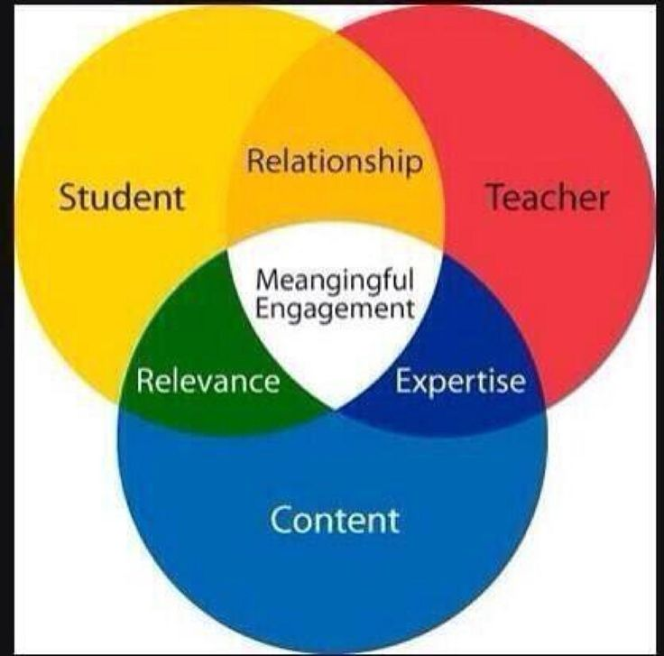
Pupils need to feel……

Slide 3
Discuss the following
‘As a teacher I should strive to be liked by all pupils.’
‘If I am ‘strict’ I cannot be caring.’

Slide 4
Share reflections from self directed study materials;
Why is it important to create a predictable learning environment?
How can the climate for learning support good behavior?
What can you do to build positive relationships?
What would you expect to see in a class where behavior management is working well?
What does a class that has mutual trust and respect look like?

Slide 5
How can you use positive reinforcement to support behavior?
Reinforce what we want to see
Focus on the positive
Convey clear expectations
Verbal and non verbal prompts
Give the pupil an opportunity to adjust behavior

Slide 6
Turn it into What you want …
‘I can’t see you getting on with your work’
‘Stop talking’
‘There is too much noise’

Slide 7
Giving clear instructions
Instructions should be short, clear and sequential?
Pupils are clear about instructions before they begin
All pupils follow instructions and are reminded if they do not.
Pupils carry out the instruction to the standard that you expect.
Use positive reinforcement strategies to deal with low level disruption
Notes:
Use these as success criteria. Do I….?

Slide 8
Task: Giving clear instructions
Task; With a lesson in mind
Give instructions, which support clarity of expectations
Imagine that the pupils do what they are supposed to
Now, deal quickly and early with two pupils who are whispering to each other instead of starting their work.
What does the teacher say? Do? How do they use their voice? Non verbal clues?

Slide 9
Planning for action with your mentor
Decide on two or three things to put into action before your next session.
Record yourself giving instructions using IRIS to share for feedback.

Slide 10
Classroom routines can be useful because….
Used for activities such as;
Entering the class
Leaving the class
Start and end of sessions
Transitions between lessons
Taking out and putting away resources
Whole class discussions
Group discussions
Handing out equipment.

