Slide 1
INTENT for mathematics
Mathematics is important in everyday life. It is integral to all aspects of life and with this in mind we endeavour to ensure that all children develop a healthy and enthusiastic attitude towards mathematics that will stay with them.
At Huntingdon we aim to:
equip children with confidence, resilience and a depth of understanding in maths that will underpin and fuel their future learning.
know that making mistakes is an essential and a valuable opportunity for new learning.
support pupils to achieve Mastery through developing their procedural fluency and conceptual understanding.
support the pupils’ ability to express their thinking about maths through talk.
ensure that all children, regardless of their ability, are given appropriate challenge and opportunity.

Slide 2
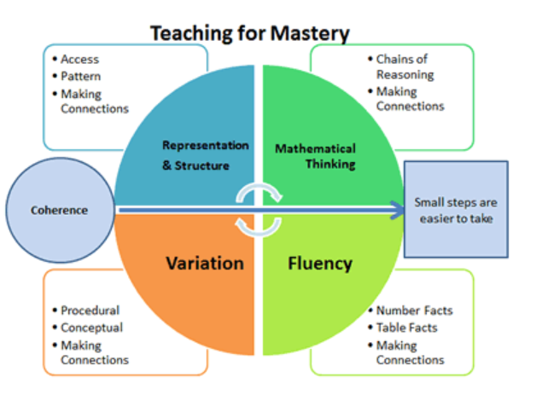
Discuss…
No cheating!
What are the 5 Big Ideas in maths?
-R
-M
-F
-V
-C

Slide 3
The 5 big ideas for maths

Slide 4
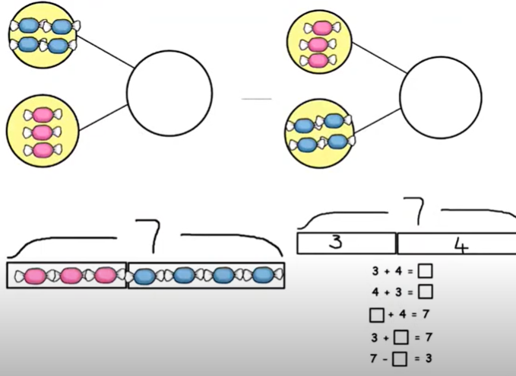
coherence
Small steps that build from each other
Lessons are taught in small, manageable chunks
Builds on from prior learning
Gradual new learning
Spend lots of time showing examples in small steps
Question the children and show them how to make links/connections
Focus on one key point each lesson
Representations are key pre-cursors to later ideas

Slide 5
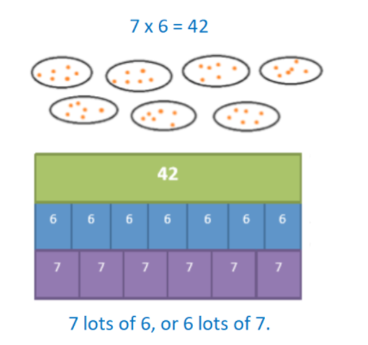
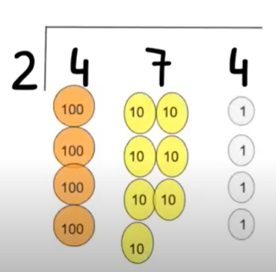
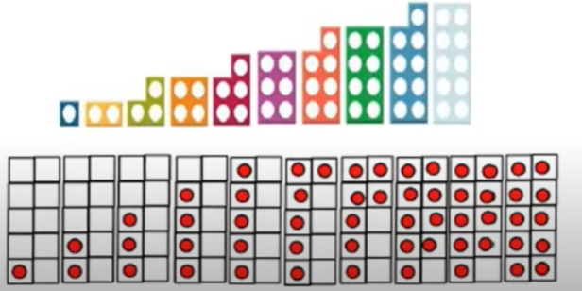
Representation and structure
CPA approach (concrete → pictorial → abstract).
Carefully chose representations
Access to manipulatives
Representing the concept in different ways
Exposing the concept

Slide 6
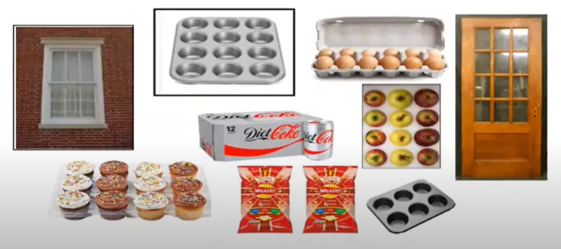
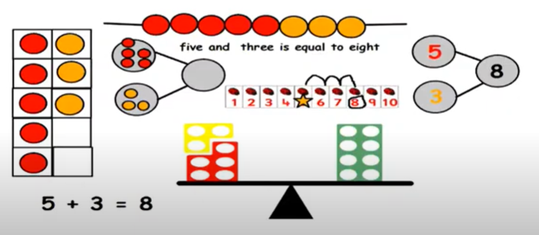
Mathematical thinking
Oracy
SLAM – Speak Like A Mathematician
Sentence stems
Key vocabulary
Verbal and written reasoning
Finding links and patterns
Connecting ideas to past learning
Active engagement
Questioning

Slide 7
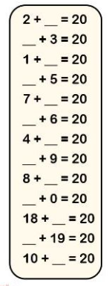
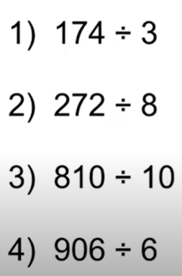
fluency
Quick and efficient recall of facts and procedures and the flexibility to move between different contexts and representations of mathematics.
Spot patterns
Children can identify the most appropriate method
Making links
Move between contexts and representations
Frees up the children’s brain so they can delve deeper into the maths
30 minute stand alone fluency session
KIRFs – Key Instant Recall Facts
TT Rockstars

Slide 8
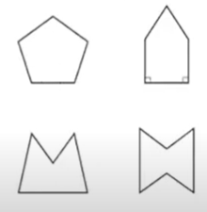
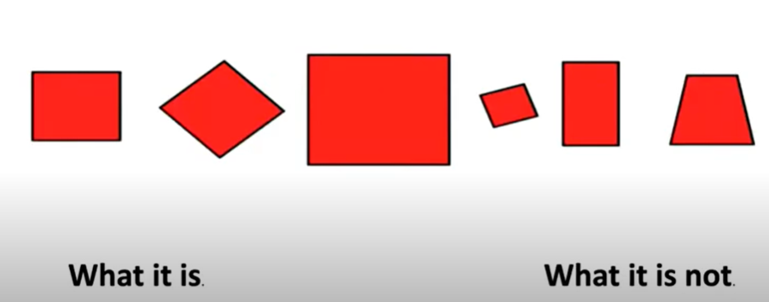
variation
Conceptual variation – how the information is presented changes
Procedural variation
– vary the problem
multiple methods of solving a problem
Multiple applications of a method to similar problems
Variation is about how the teacher represents the concept being taught
What stays the same and what changes / is different
What it is and what it is not
How can we group these quadrilaterals?
Circle the pentagon with exactly 4 acute angles.

Slide 9
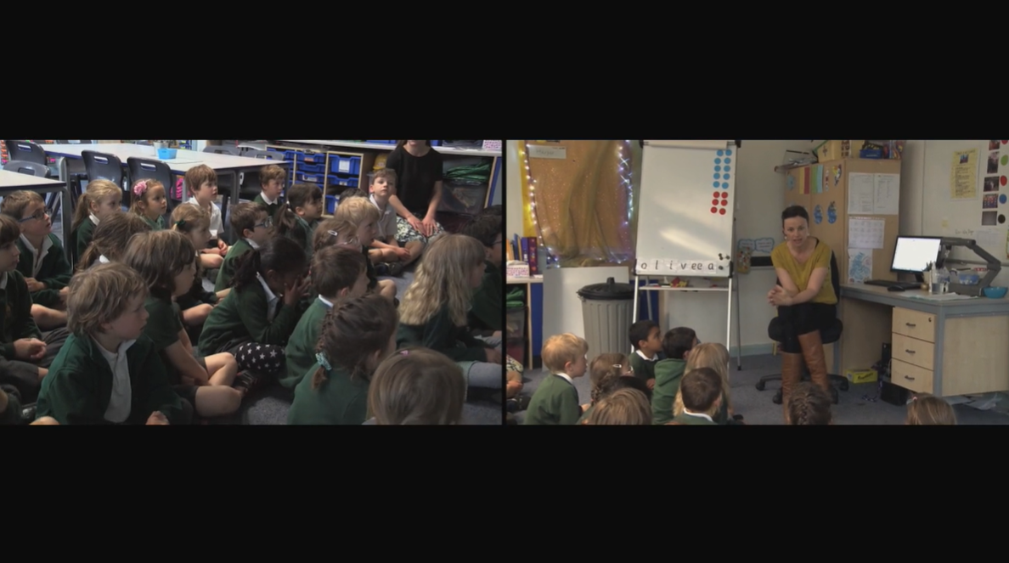
Watch the video
https://www.ncetm.org.uk/classroom-resources/lv-a-year-1-lesson-on-difference-as-a-form-of-subtraction/
Can you spot the 5 big ideas:

