Slide 1
L.E.A.D. Teaching School Hub
ECF PDP
Spring Term Mentor Regionals
January 2023
Notes:
11:10-11:15 – introduce myself

Slide 2
Deepening Instructional Coaching
ECF PDP
Spring Term Mentor Regionals
January 2023
Notes:
Put simply – instructional coaching involves a trained expert working – be it an external coach, leader teacher or peer – with teachers individually, to help them learn and adopt new teaching practices, and to provide feedback on performance.
This session is aimed at taking a deeper look at instructional coaching. Instructional coaching was created by Jim Knight.
Jim Knight has worked as a trainer, developer, and researcher in instructional coaching for many years and has broad experience not only training coaches but also collecting data about the effects of his coaching program. He has a Ph. D. in Education from the University of Kansas and has won several university teaching, innovation, and service awards. This learning comes from a pace of ensuring that we are developing the profession as a profession.

Slide 3
Introductions
Rebecca Riley
Head of School
Accredited Coach
PGCERT in Personal and Business Coaching and a
PGCERT in Mentoring and Coaching Beginning Teachers
Team Coaching Practitioner
ECF PDP Facilitators
Notes:
Introduce myself. Pleasure to be working with professionals who have the same interest in supporting, developing and empowering others. Interesting space linked heavily to psychology- how do we help people to thrive!

Slide 4
Contracting
How is it important that we show up today for this session? What I ask of you? What do you ask of me?
Be present
Be ready to honestly reflect on your practice to date
Be prepared to learn something new
Be ready to contribute
Notes:
When we first begin any type of coaching work, we should contract with our partner. How do you like to work? How do I like to work? What is confidential and what isn’t?

Slide 5
Self Reflection
What makes an effective instructional coach?
How do you think you are doing so far?
Notes:
11:15 – 11:20 – thinking question
Release the poll
I am an expert at instructional coaching
I have a good understanding of instructional coaching
I have an average understanding of instructional coaching
I have some understanding of instructional coaching
I have little understanding of instructional coaching
Note down – what are you proud of? What might you need to do more of that would serve your ECT well?

Slide 6
I am an expert at instructional coaching
I have a good understanding of instructional coaching
I have an average understanding of instructional coaching
I have some understanding of instructional coaching
I have little understanding of instructional coaching
Note down – what are you proud of? What might you need to do more of that would serve your ECT well?

Slide 7
What are the Key Aspects of Instructional Coaching?
Partnership
Reality
Meaningful goals
Explicit strategy
Modelling
Reflection
Let’s use a coaching tool of scaling here. On a scale of 1-10. Where would you place yourself in each section?
Where does your strength lie?
What would you like to do more of?
Notes:
11:20 – 11:25
n front of you write these words and then scale yourself 1-10. Take a look at how you have rated yourself?

Slide 8
What is Instructional Coaching?
Surface Deep
Notes:
Instructional coaching is a process that aims to run deeply with someone’s development. How deep are you going?

Slide 9
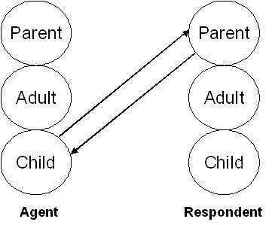
Transactional Analysis
Which one are you operating in with your ECT?
Notes:
11:30 – 11:35 – talk through these next two slides. Explain that transactional analysis is psychoanalytic theory and method of therapy, developed by Eric Berne during the 1950s and is relevant in the world of coaching and mentoring.

Slide 10
Transactional Analysis
Instructional coaching should be mainly operating here.
Notes:
11:30 – 11:35 Ask mentors where they are currently operating.

Slide 11
Questions for Coaches
Are your coaching conversations creating a thinking environment?
Are your coaching conversations creating a professional?
Notes:
11:35 – time for reflection. The way we develop people plays a crucial part to their development. If we want to continue to empower the profession then we need to consider the role we play.

Slide 12
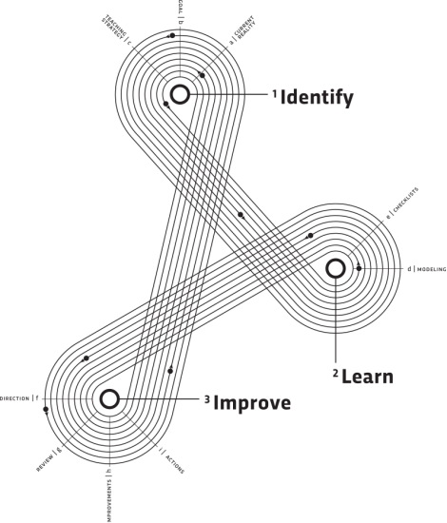
Notes:
If you want to read more about this then this is the book that goes into real detail about instructional coaching. 10 years ago this book was written and it has had a profound impact on professional practice and launched a movement.

Slide 13
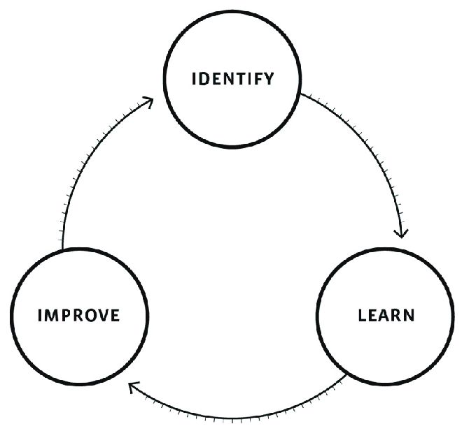
How effectively are we applying the impact cycle to our instructional coaching?
A deceptively simple
process.
Notes:
11:35- 11:50 – we are going to look at the impact cycle in a little more detail now. Talk through these next slides
Identify is spending time to look at the current reality and set a meaningful goal. Learn is to use checklists and modelling etc to implement a chosen strategy that was chosen to achieve the goal. Improve is coming coached back together to check in on where we are now. Healthy accountability is essential to instructional coaching.

Slide 14
How effectively are we applying the impact cycle to our instructional coaching?
Identify
The coach and teacher collaborate to set a goal and select a teaching strategy to meet the goal.
Learn
The coach explains and models teaching strategies so the teacher can learn how to implement the strategy.
Improve
The coach monitors how the teacher implements the teaching strategy and whether students meet the goal. Then coach and teacher decide any adjustments necessary for the practice to be as effective as possible.
Notes:
Identify is spending time to look at the current reality and set a meaningful goal. Learn is to use checklists and modelling etc to implement a chosen strategy that was chosen to achieve the goal. Improve is coming coached back together to check in on where we are now. Healthy accountability is essential to instructional coaching.

Slide 15
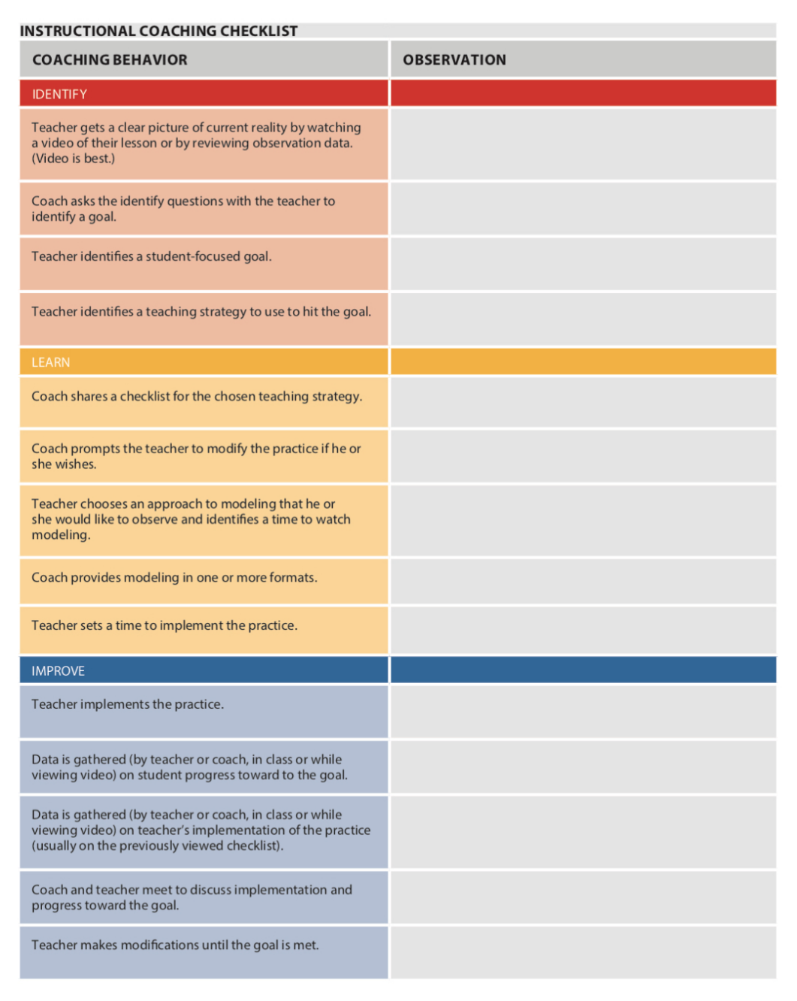
Reflection
What elements of the checklist are you using well?
What might it benefit your ECT for you to do more of?
Discuss
Notes:
11:40 – 11:45 break out room. Ask mentors to self evaluate their practice.
Identify is spending time to look at the current reality and set a meaningful goal. Learn is to use checklists and modelling etc to implement a chosen strategy that was chosen to achieve the goal. Improve is coming coached back together to check in on where we are now. Healthy accountability is essential to instructional coaching.

Slide 16
Confronting Reality
“To confront reality is to recognise the world as it is, not as you wish it to be, and to have the courage to do what must be done, not what you’d like to do.”
Bossidy and Charan, 2004
IRIS
Notes:
11:45 – 11:50-The importance of the reality section. The use of the iris. If we don’t spend time looking at reality then how do we know the most purposeful goal to set. Often we need help to see our reality from a coach.

Slide 17
Are we helping our beginning teacher set themselves meaningful goals?
Goal
Strategies
Current Reality
Notes:
Getting a clear picture of reality is the launching point. Teachers have to make hundreds of decisions a day so sometimes having the time to get an accurate picture of what is actually happening can be a challenge. Video and use of the iris is key and recommended in instructional coaching.

Slide 18
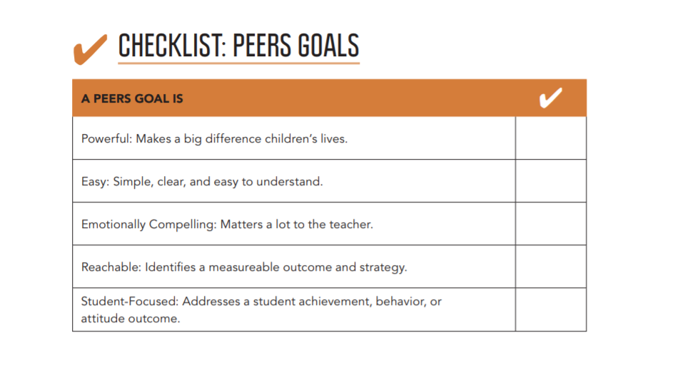
PEERS Goals
Reflection
Do you think the goals you and your ECT have been setting would hit this checklist?
What are you doing well at in this space? What might you need to do more of?
Notes:
Goals should be pupil focused. What will the impact be on the children if this goal is achieved? Goal usually related to attitude, behaviour and achievement.

Slide 19
Identify Questions
On a scale of 1-10, how close is the lesson to your ideal?
Why did you give it that number? What went well?
What would have to change to make it closer to a ten?
What would you see your students doing differently?
Describe what that would look like?
How could we measure that?
PAUSE! PARAPHRASING WHAT YOU’VE HEARD, Then, should that be your goal?
If you could reach that goal, would it make a difference in your classroom?
Would it be a good use of your time?
What teaching strategy would you like to try to achieve your goal?
Notes:
Tips for helping an ECT to set appropriate goals.
Goals should be pupil focused. What will the impact be on the children if this goal is achieved? Goal usually related to attitude, behaviour and achievement.

Slide 20
Video here
Notes:
Make some notes. What are you noticing? Would anyone like to share?

Slide 21
The Learn Stage
The coach will ensure that the teacher has had the
opportunity to learn the new strategy.
How do you help your ECT to learn? Use the chat box.
Notes:
11:50 – 11:55 Explanation has to be crystal clear- the power of checklists. Show some examples. The teacher is the thinker. When I share a checklist I may say, this is what the research says but you might want to modify this for what works in your classroom. The strategy is precise and clear but ultimately you let the beginning teacher make the decisions. Can be disempowering to model behaviour management.

Slide 22
The Learn Stage
The coach will ensure that the teacher has had the
opportunity to learn the new strategy. Either through:
Explanation
Modelling
Use of checklists
Teachers like and need to see it!
Co teaching
Observing another teacher
Video
Modelling in the classroom without the children
Notes:
11:50 – 11:55 Explanation has to be crystal clear- the power of checklists. Show some examples. The teacher is the thinker. When I share a checklist I may say, this is what the research says but you might want to modify this for what works in your classroom. The strategy is precise and clear but ultimately you let the beginning teacher make the decisions. Can be disempowering to model behaviour management.

Slide 23
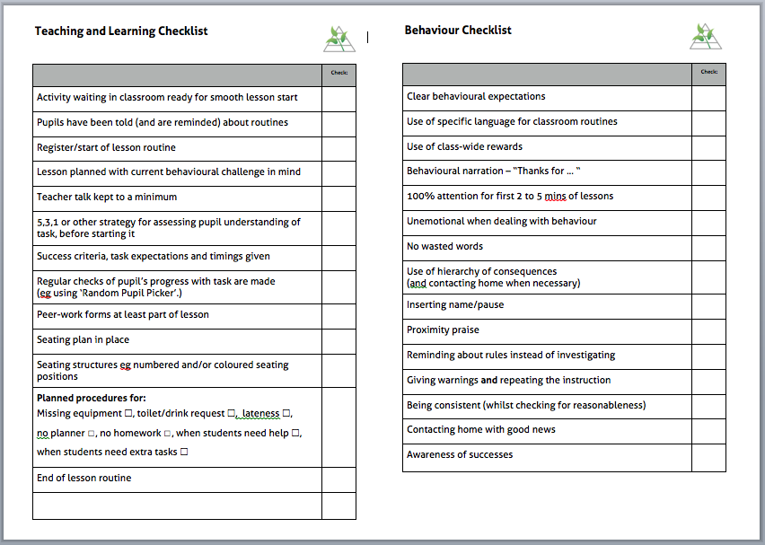
Using Checklists
Notes:
Today we find ourselves in possession of stupendous know-how, which we willingly place in the hands of the most highly skilled people. But avoidable failures are common, and the reason is simple: the volume and complexity of our knowledge has exceeded our ability to consistently deliver it - correctly, safely or efficiently. In this ground-breaking book, Atul Gawande makes a compelling argument for the checklist, which he believes to be the most promising method available in surmounting failure. Whether you're following a recipe, investing millions of dollars in a company or building a skyscraper, the checklist is an essential tool in virtually every area of our lives, and Gawande explains how breaking down complex, high pressure tasks into small steps can radically improve everything from airline safety to heart surgery survival rates. Fascinating and enlightening, The Checklist Manifesto shows how the simplest of ideas could transform how we operate in almost any field.

Slide 24
The Learn Stage- Practice and Refine
Implement the strategy while the coach observes.
Did we hit the goal?
What works? What needs improving?

Slide 25
Improve: Confirm Direction
Given the time we have today, what’s the most important thing for us to talk about?
What is on your mind?
Notes:
11:55 -12:00

Slide 26
Improve
Did you hit the goal?
DO YOU WANT TO: A: continue to refine the use of the practice?
B: choose a new goal?
C: take a break?
DO YOU WANT TO: A: revisit how you teach the new practice
B: choose a new practice?
C: stick with the practice as it is?
Notes:
Maybe we need more time

Slide 27
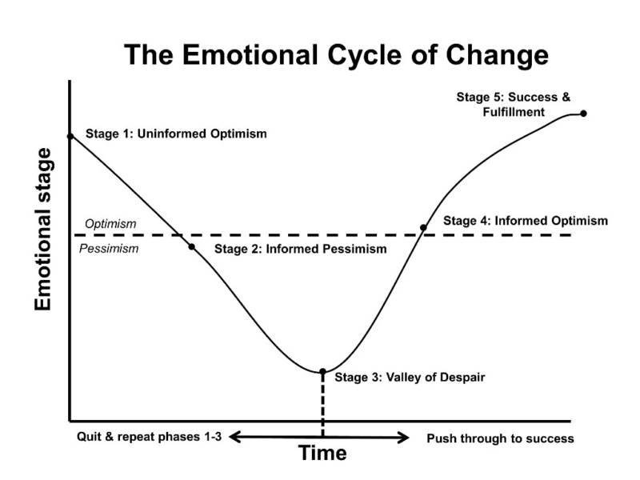
Notes:
When teachers are in the valley of despair – a coach can help them through the dip. Coaches can coach us up and out of it!
Confirm direction. Fierce conversations.
Review progress- what is going well? What progress has been made towards the goal? What are you learning? What obstacles are there?

Slide 28
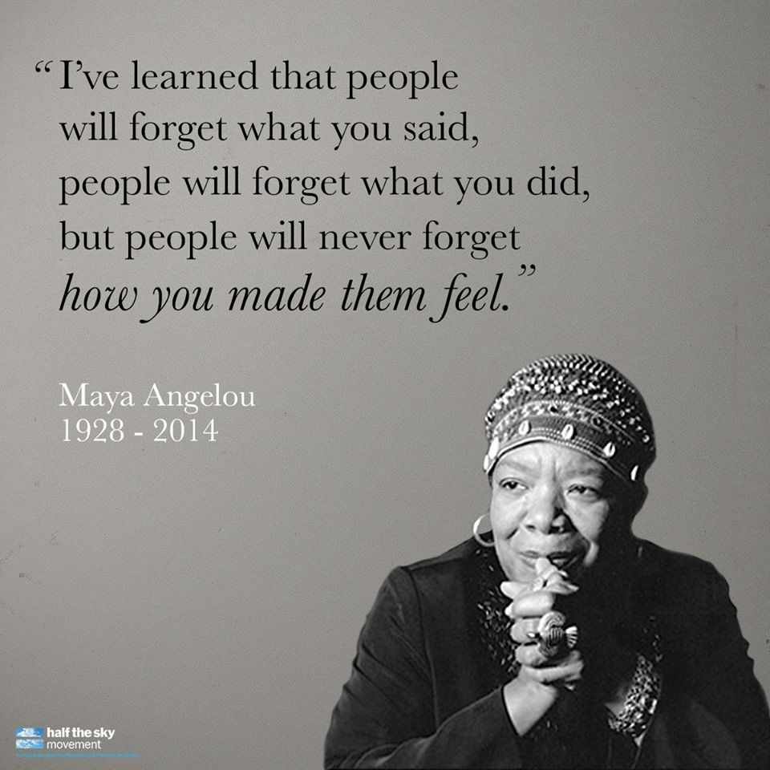
Notes:
Are you empowering your ECT? How is your ECT feeling? Have you asked for feedback?

