Slide 1
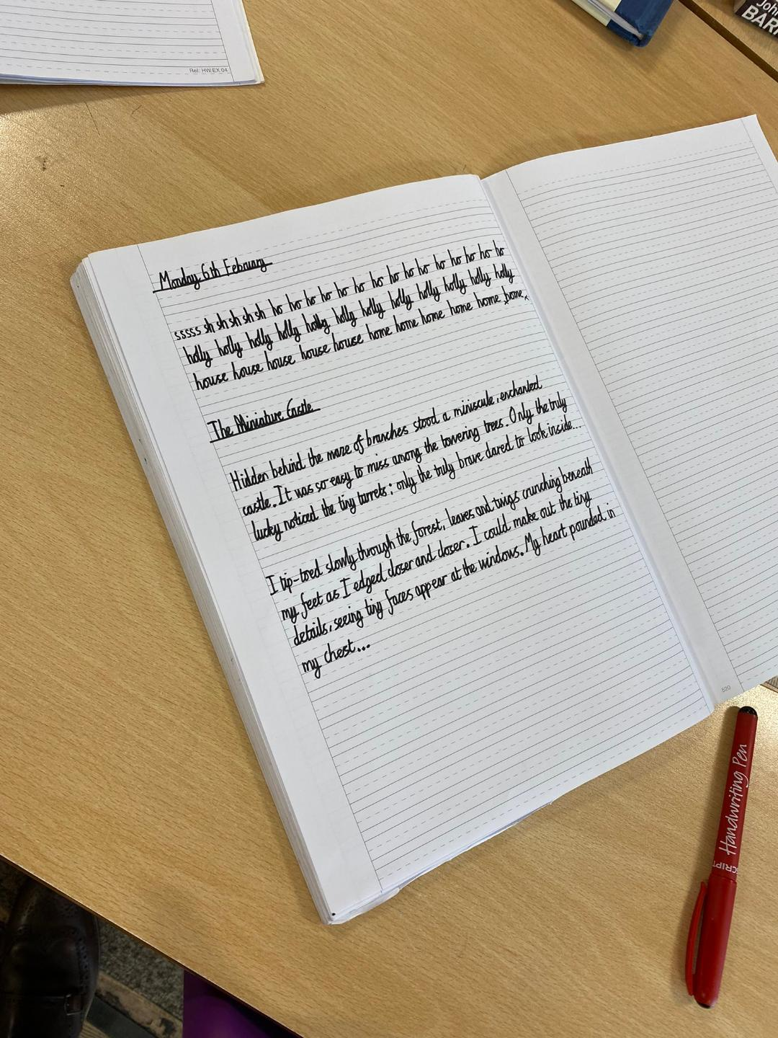
Handwriting and spelling colleague meeting

Slide 2
Aims of the meeting
Ofsted views on handwriting and spelling
What a handwriting lesson should look like
What a spelling lesson should look like

Slide 3
INTENT for Handwriting and spelling
At Huntingdon Academy, we believe that all pupils should be able to confidently communicate their knowledge, ideas and emotions through their writing. We want pupils to be able to spell new words by effectively applying the spelling patterns and rules they learn throughout their time in primary school. We believe that all pupils should be encouraged to take pride in the presentation of their writing, in part by developing a good, joined, handwriting style by the time they move to secondary school.
At Huntingdon Academy, we understand the importance of parents and carers in supporting their children to develop both grammar, spelling and composition skills, and so we endeavour to develop a home-school partnership which enables parents and carers to understand how to enhance the skills being taught in school.

Slide 4
End points for Handwriting and spelling
EYFS:
Some words are spelt correctly and others are phonetically plausible
KS1:
Segment spoken words into phonemes and represent these by graphemes, spelling many of these words correctly and making phonically-plausible attempts at others
Spell many common exception words
Form capital letters and digits of the correct size, orientation and relationship to one another and to lower-case letters
Use spacing between words that reflects the size of the letters
KS2:
Spell correctly most words from the year 5 / year 6 spelling list, and use a dictionary to check the spelling of uncommon or more ambitious vocabulary
Maintain legibility in joined handwriting when writing at speed

Slide 5
Our strengths at Huntingdon
Phonics is providing a solid foundation for spelling in EYFS, KS1 and lower KS2
We set high expectations for communication
Children are proud of their work and achievements

Slide 6
Ofsted ENGLISH review 2022
Children get the practice they need to acquire fluent transcription skills (spelling and handwriting), which is the foundation for their progress in writing.
Carefully chosen dictation activities enable pupils to practise and apply their spelling knowledge and segmenting skill to use the content they have been taught and to do so without having their working memories overloaded by composing sentences.
There is also evidence that repeated practise in handwriting, going beyond accuracy to fluency, leads to success in higher-level writing tasks.

Slide 7
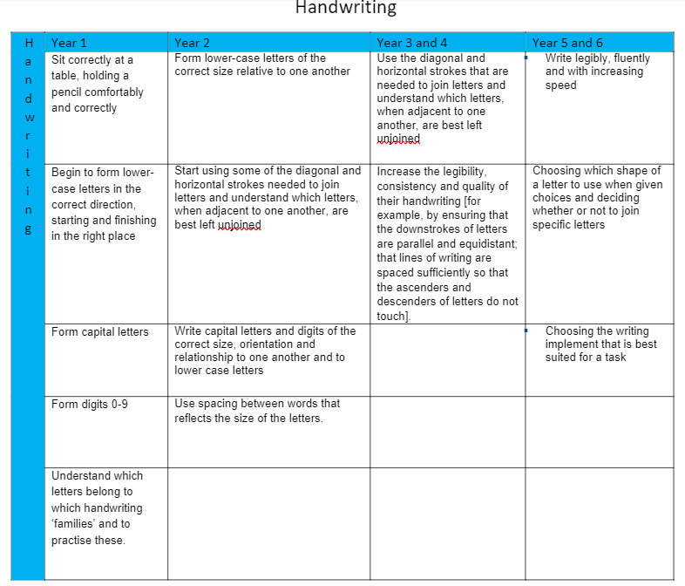
Handwriting

Slide 8
handwriting lessons
• Handwriting should be taught for 5- 10 minutes every day in KS1 and 10 – 15 minutes every day in KS2.
Handwriting practice should be completed on one page in English books per week.
• Everyone should be using the Nelson Handwriting programme on the Oxford Owl (please let me know if you need a log in or a teacher book).
• You can assess your class and decide on an appropriate point to start the programme; for example year 4 might decide that the units in year 3 would be more beneficial for their children – use your own judgement.
• Handwriting font to be used on worksheets.

Slide 9
Handwriting lessons

Slide 10
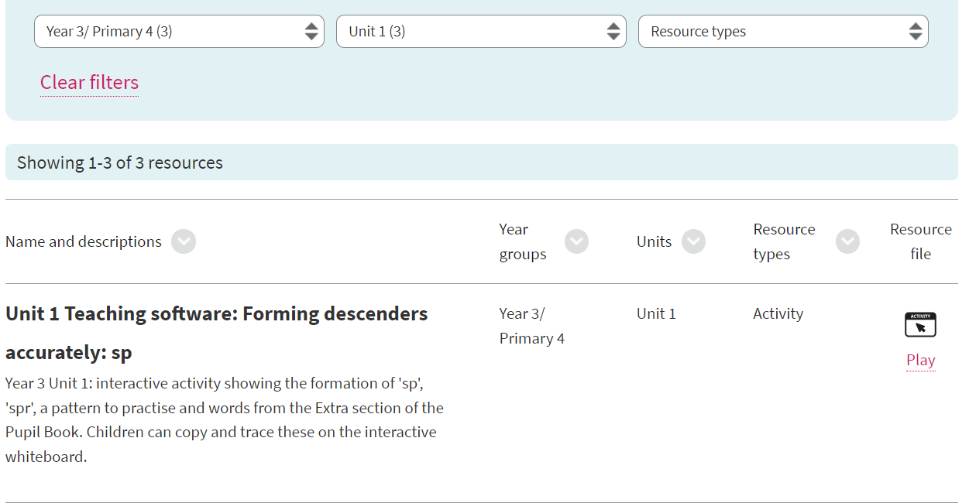
Handwriting lessons

Slide 11
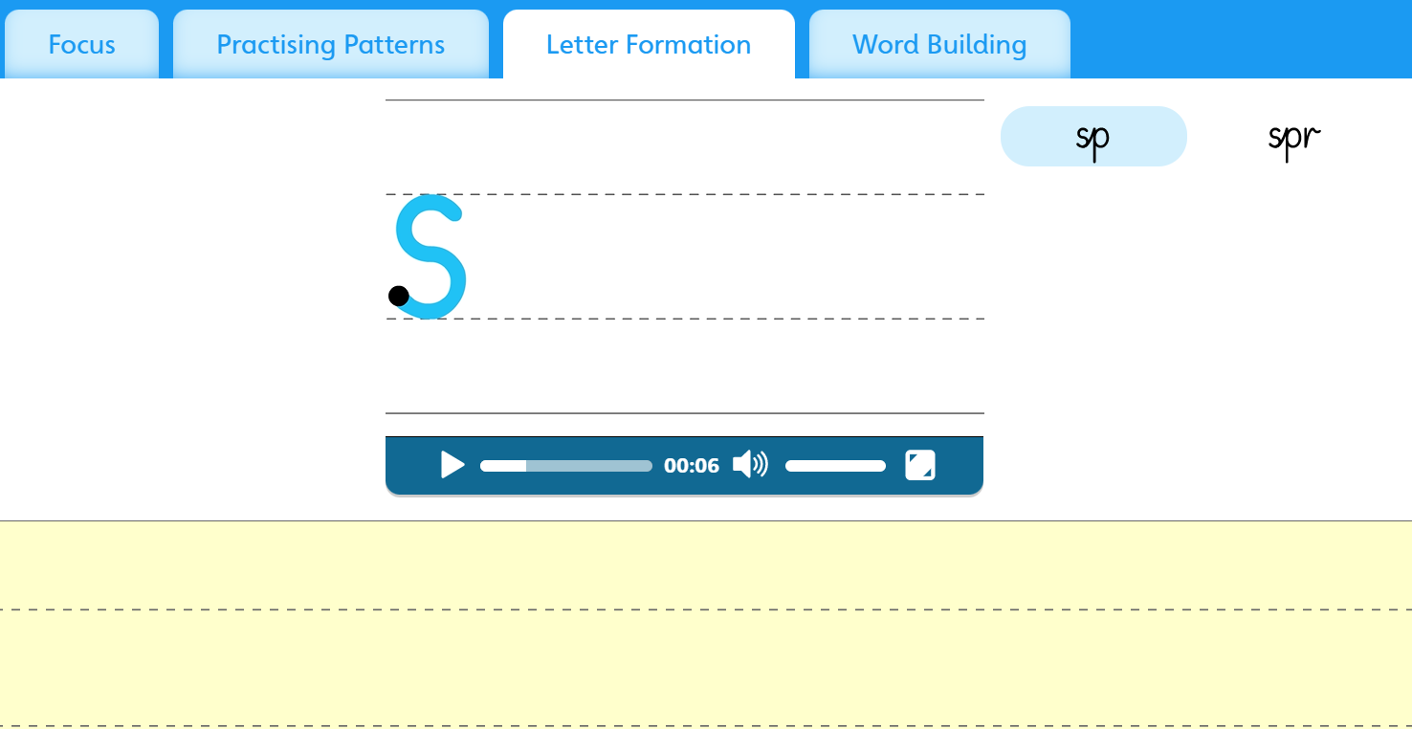
Handwriting lessons
At the beginning of each lesson start the session by checking that everyone is sitting appropriately and holding their pencil correctly.
Watch the introduction to the focus letter formation and practise the patterns on the Oxford Owl programme.

Slide 12
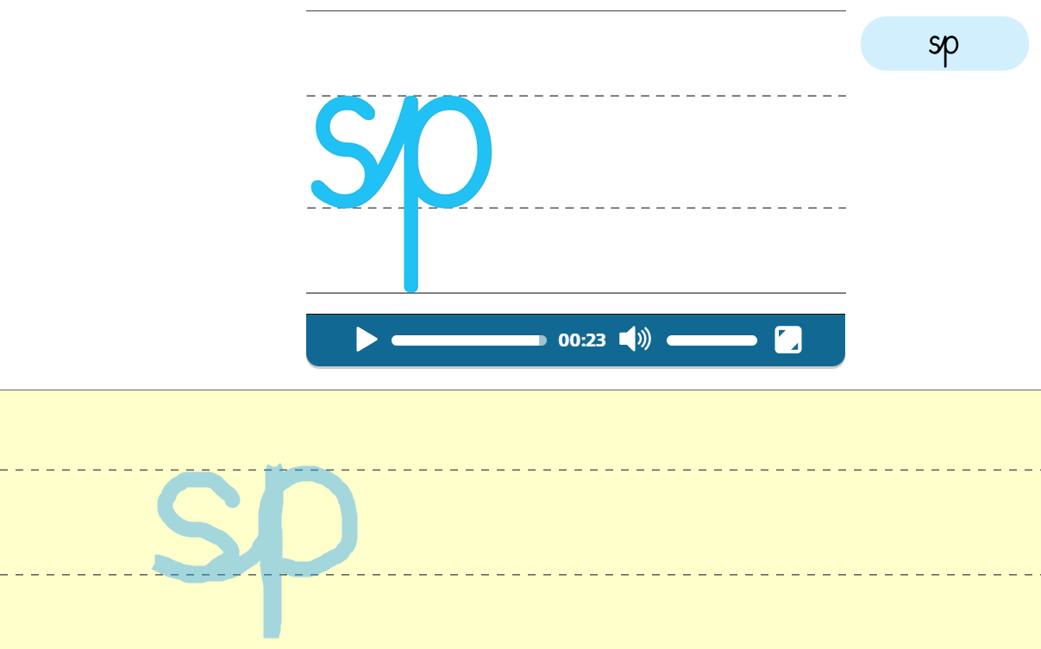
Handwriting lessons
Then model write the patterns and letter formations for the children – explaining clearly where you are starting and finishing your letters; if letters are ascenders or descenders and pointing out common mistakes that could be made.

Slide 13
Handwriting lessons
Allow children an opportunity to practice the letter formations. This may vary depending on the age of the children from: writing in the air, on a partner’s back/hand, to writing in books in upper key stage 2.
As children move on to practice in their books live mark to check that everyone has a secure understanding and identify any children that may require further interventions. At this point also check pencil grip is being used correctly.
Whilst live marking assess the children that would benefit from further intervention.

Slide 14
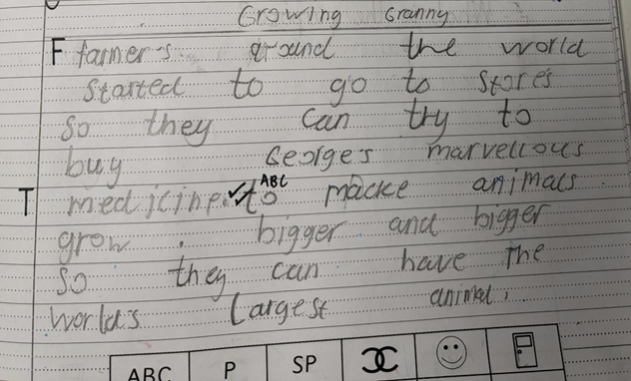
Handwriting lessons
Interventions:
Focus for intervention would be on spacing
between words
Focus for intervention would be on joining from the
letter ‘s’ and highlighting which letters are ‘break’
letters.

Slide 15
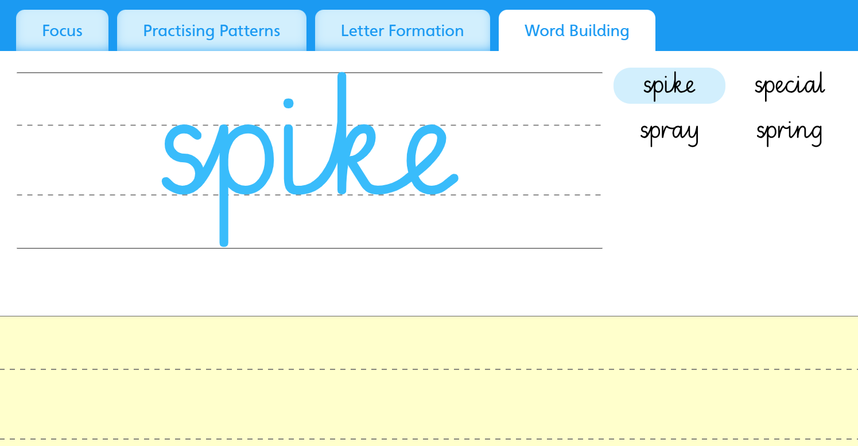
Handwriting lessons
When the children are secure with the letter formations move onto the word builder section. Again watch, model and then practise the skill.

Slide 16
Handwriting lessons
Challenge for secure writers
These children could focus on spelling patterns, for example if the spelling rule was ‘sp’ words they could find more ‘sp’ words and work on writing and spelling them correctly. Using peer assessment where appropriate.
A range of activities can be found in the spelling programme that could be used during handwriting time for children that have secure handwriting for their age group.

Slide 17
Handwriting lessons
Consistency in all lessons
The high expectations set in handwriting lessons should then be applied to all pieces of written work. With adults talking through their own handwriting when modelling writing in all lessons.
It would be a nice idea to have hand writer of the week or most improved hand writer and display their name / picture next to a piece of work that the child has produced.

Slide 18
spelling lessons
• From year 2 (when appropriate) to year 6 Read Write Inc. spelling programme should be taught for 15 minutes daily.
• Everyone should be using Read Write Inc. Spelling from the Oxford Owl scheme (please let me know if you need a log in or a teacher book).
All children should have their own Read Write Inc. Spelling practice book.
Children should complete partner work with partner who is of similar ability in spelling.

Slide 19
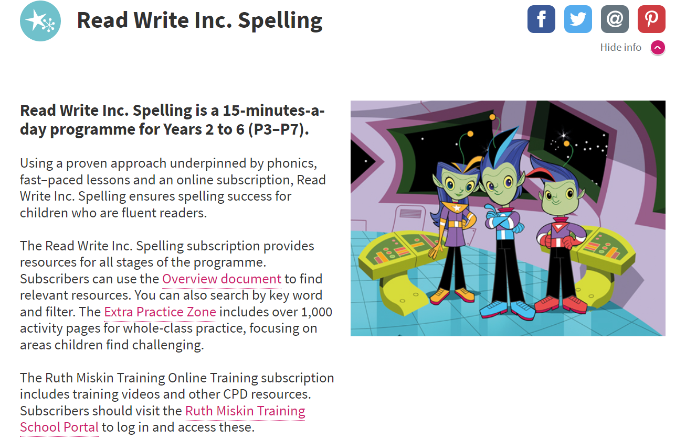
Spelling lessons

Slide 20
Spelling lessons

Slide 21
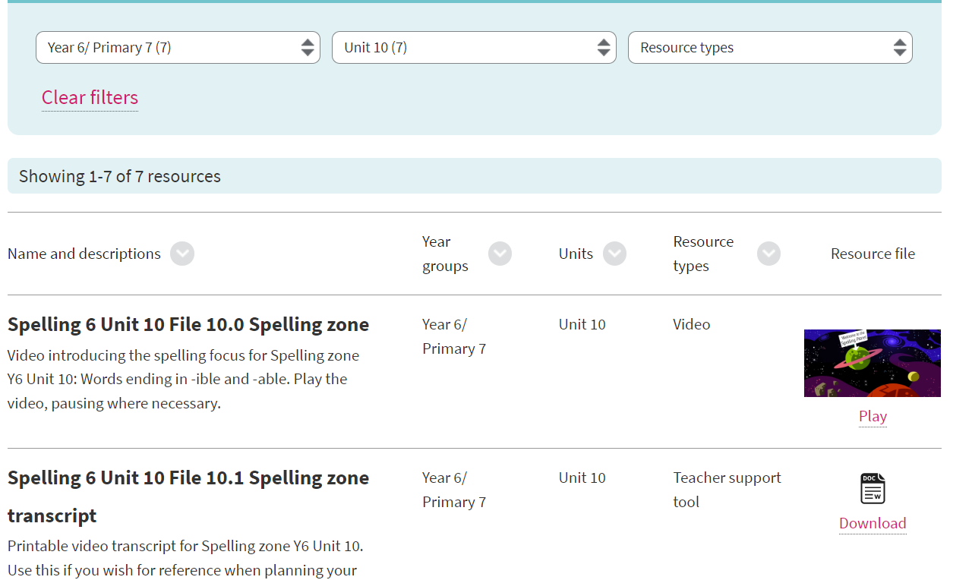
Spelling lessons
• A video introduces the spelling focus at the beginning of each unit.
(transcripts are also available)

Slide 22
Spelling lessons
• The speed spelling words for each unit can be downloaded from the ‘word bank’ section.
These should be 6 words that the children found tricky from the previous unit.
Use my turn / your turn to read each word and then hide the word and ask the children to write it down.
Any incorrect words should be recorded in their spelling log.

Slide 23
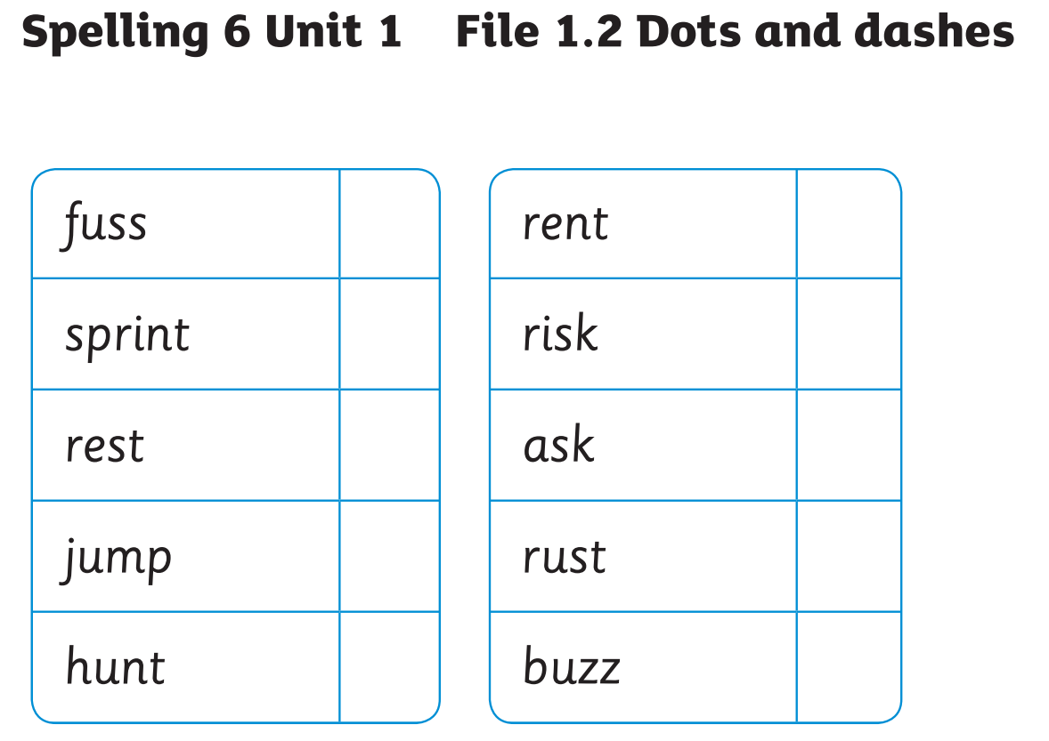
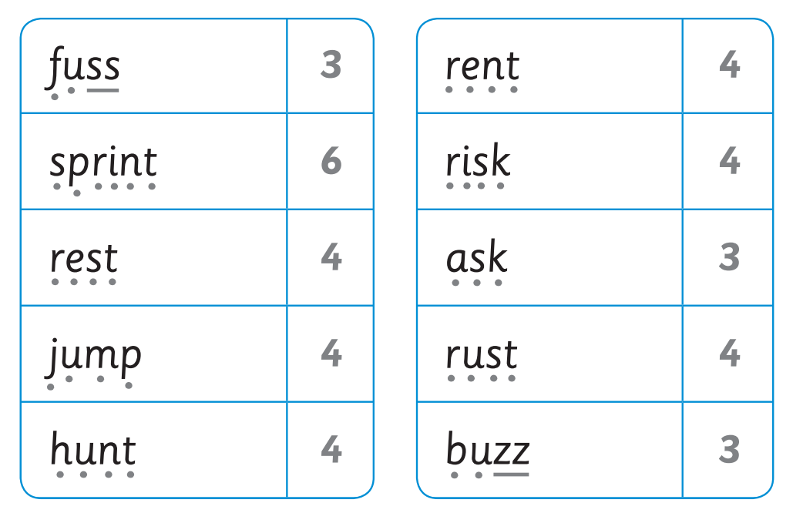
Spelling lessons
• There follows a range of activities designed to reinforce the spelling focus the children are working on for the week.
For example ‘Dots and dashes’ - the children are expected to dot and dash the graphemes in the words.
Correct answers can be found on the online programme.

Slide 24
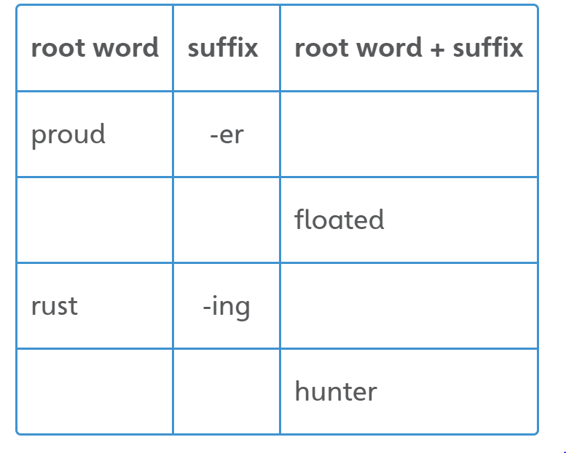
Spelling lessons
Word changers
This encourages the children to consider how words are changed by adding a suffix. Developing independent thought and critical thinking.
Challenge higher ability children to find other words that follow the same patterns / rules.

Slide 25
Spelling lessons
Dictation:
Carefully chosen dictation activities enable pupils to practise and apply their spelling knowledge and segmenting skill to use the content they have been taught and to do so without having their working memories overloaded by composing sentences.
Dictation also gives the children time to use their oracy skills and focus on clear communication whilst working collaboratively with a partner.

Slide 26
Spelling lessons
Team Teach:
Focus is on collaboration and communication during this task.
• Children work in groups of 4-6 (or smaller if more appropriate) and choose 10 words (or fewer if necessary) that they have found challenging that week/unit.
• The children work together to order the words in difficulty by identifying the challenging part of each particular word.
• Each team selects a team leader to stack the words with the easiest on top. The team leader then calls out the words for the others to spell and checks that they have spelt it correctly.

Slide 27
Spelling lessons
Jumping Red / Orange Words:
• Have a box of cards of the red/orange words (can be downloaded from the oxford owl website) as well as words that the children are commonly misspelling.
• Read out 6 words from the box and ask children to write them in their Practice Book.
• The words can only ‘jump out’ of the box when everyone is confidently spelling them. They must go back into the box if they are spelt incorrectly.
Red / orange words should be displayed in the classroom when the children are focusing on them.
NB : Red/Orange words are the common exception words and the word lists from the National Curriculum Spelling lists.

Slide 28
Spelling lessons
Assessment:
Consolidation activities can be found online for all the units
Tests are provided after the completion of 2 units
Tests are also provided for the orange word lists

Slide 29
What to do now:
Ensure handwriting lessons are happening daily
Ensure handwriting is being modelled in all lessons and that expectations of handwriting are consistent in all subjects
Ensure spelling lessons are happening daily
Ensure incorrect spellings are being picked up in all curriculum areas

