Slide 1
KS 2 assembly

Slide 3
Worldbookday.com Audio books
https://www.worldbookday.com/stories/strong-and-tough-bloomsbury-early-reader/

Slide 4
Reasons to read
How many reasons to read can you think of?

Slide 5
What are Protected characteristics?
The nine protected characteristics are:
age
disability
gender reassignment
marriage and civil partnership
pregnancy and maternity
race
religion or belief
sex
sexual orientation
Notes:
Refer to assembly delivered by LY. Why these have been identified and why are they protected?

Slide 6
Use your £1 book voucher!
Your local independent bookseller
Asda
Blackwell’s (selected stores only)
Morrisons
Sainsburys
Tesco
The Works
Waterstones
WHSmith

Slide 7
Reading before bed
Why might reading before bed be a good thing?
It does help your mental well being
There's no denying that books can help you dream big, day or night. But diving into the pages of a book before bed might help you relax before you crawl between your sheets. Reading before bed, then, could promote restful sleep, and maybe even more interesting dreams.

Slide 8
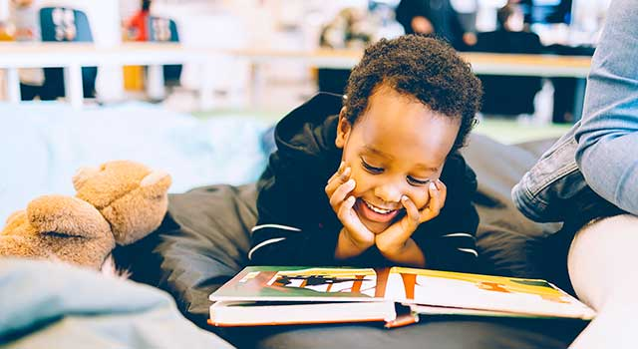
Reading for pleasure
Reading for pleasure is the single biggest indicator of a child’s future success – more than their family circumstances, their parents’ educational background or their income.
We want to see more children with a life-long habit of reading for pleasure and the improved life chances this brings them.

Slide 9
Reading aloud
How does reading aloud help you?
Reading aloud helps us remember words and texts better than if we read them silently.
This memory-boosting effect of reading aloud is particularly strong in children, but it works for older people, too!

Slide 10
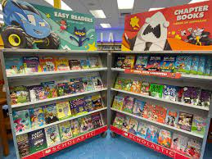
How will we recognize world book day?
THEME-; BEDTIME STORIES
On…Friday 3rd March
Dress…come in your pyjama’s (sensible ones!)
Bring….your favourite book to share
Activities…. Share your favourite books and complete a class reading activity!
There will be a prize for KS1 and KS2 for the best submissions.

Slide 11
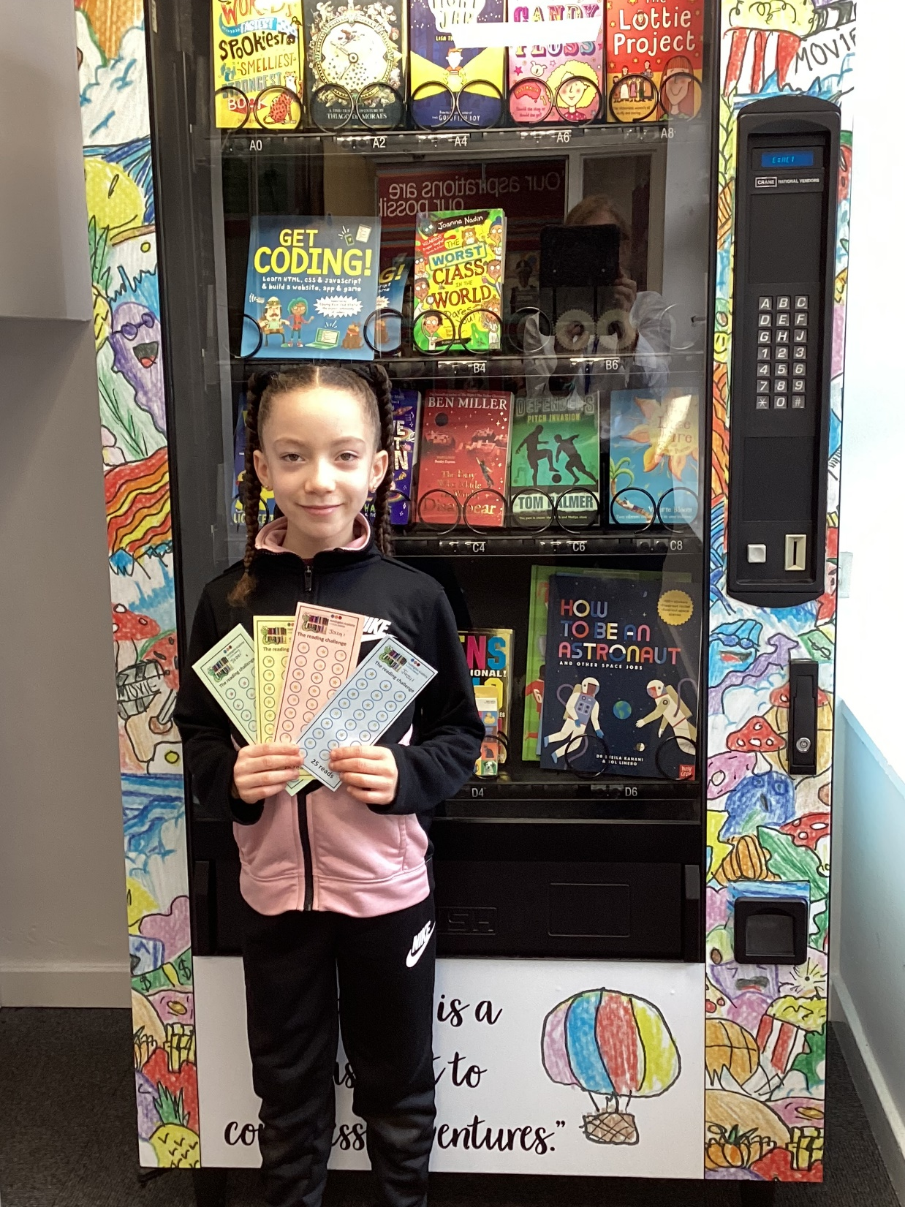
Reading challenge
Spending just 10 minutes a day reading and sharing stories with children can make a crucial difference to their future success and it’s fun for all involved.
Do you read for pleasure?
How could you make sure that this happens? Just for 10 minutes a day!

Slide 12
Top texts for ks2
These are some top texts for this month. What would your top text be? Make sure that you tell us and others about your top texts!

Slide 13
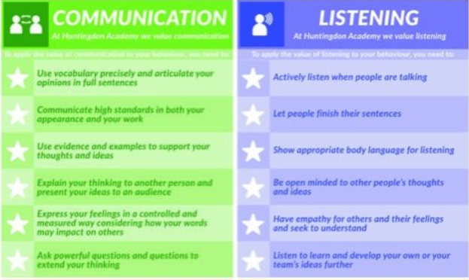
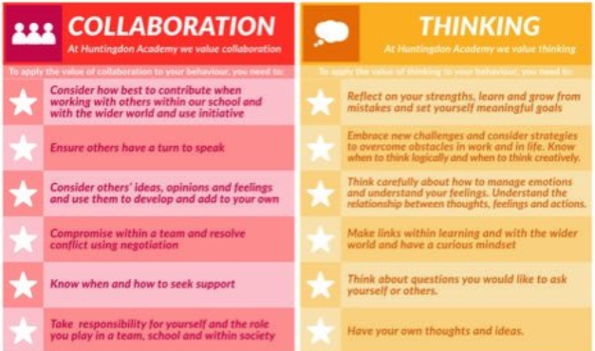
In what way is racist behavior not in line with our school values?
Notes:
It is not!!

Slide 14
In what way is racist behaviour not in line with our British values?
Mutual Respect
Treating others as you want to be treated
Respect for each other
Working together
Democracy
Making decisions together
The right to an opinion/voice
Tolerance
Learning about different faiths and cultures
Listen to other viewpoints
Learning about diversity
Individual Liberty
Freedom of speech for all
The right to make our own choices
Rule of Law
Understanding rules and why they are important
Following rules to develop order
Notes:
Everyone has these rights in the UK.- Racism is not in line with our British values!!

Slide 15
