Slide 1
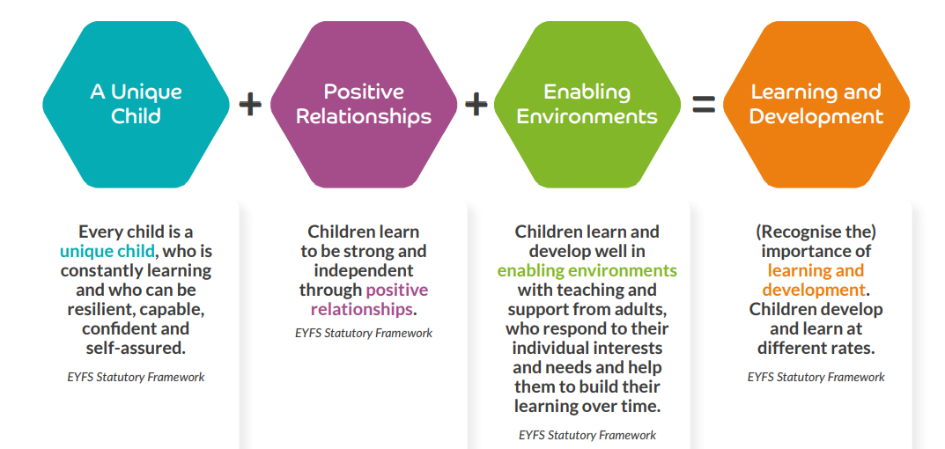
Foundation 2 – Reception Curriculum 23/24
Overarching Principles | We believe strongly in the importance of putting children at the centre of our practice. The four principles of effective practice, outlined in the Statutory Framework for the early years foundation stage (2021) and presented in Birth to 5 Matters (2021), guides how we support children in their learning and development during the foundation stage at Huntingdon Academy. We value each of these elements as essential components to effective teaching and learning
Characteristics of effective learning | Our curriculum, teaching and provision is carefully designed to reflect the ‘characteristics of effective learning’ (Birth to 5 matters, 2021), which are behaviours children use in order to learn (learning behaviours): Playing and Exploring (engagement) -finding out and exploring -playing with what they know -being willing to ‘have a go’ Active Learning (motivation) –being involved and concentrating -continuing to try -enjoying achieving what they set out to do Creative and Critical Thinking (thinking) -having their own ideas -making links -working with ideas Our direct teaching and provision aims to stimulate curiosity and enthusiasm, thus making learning meaningful to the child. Our foundation stage puts play at the heart of this learning, as we appreciate the power of play across all areas of development. As children immerse themselves in what interests them, they find out about themselves, others, and the world around them.

Slide 2
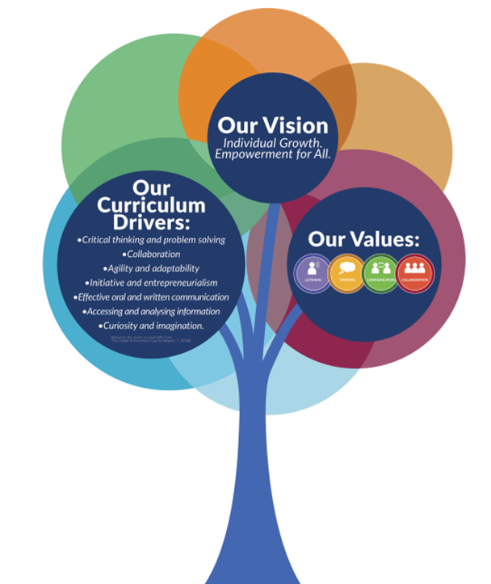
Foundation 2 – Reception Curriculum 23/24
Characteristics of effective learning + Huntingdon Academy’s curriculum drivers |  | Our curriculum and the provision we offer provides many opportunities for our pupils to demonstrate and develop the characteristics of effective learning. These CoEL link closely to Huntingdon Academy’s curriculum drivers which are listed below: -critical thinking and problem solving -collaboration -agility and adaptability -initiative and entrepreneurialism -effective oral and written communication -accessing and analysing information -curiosity and imagination We promote 4 key values at Huntingdon and these are referenced and celebrated in our direct teacher inputs, as well as in children’s play: Listening Thinking Communicating Collaborating

Slide 3
Foundation 2 – Reception Curriculum 23/24
Key Skills | As a team we identified some of the key skills we would like children to develop during their time in early years at Huntingdon Academy. We believe that these skills help to develop independence and promote the overall success of children as learners. The children will have lots of opportunities to practice these skills, often daily. Whilst at school, will support children when learning to achieve a skill, however we know it is important not to do these things for children all the time, as it does not allow children the chance to practice. Key skills: -holding pencil or mark making tools in tripod grip -dressing/undressing independently -putting on own shoes and fastening Velcro -putting on and zipping up own coat -toileting and washing hands independently -using cutlery effectively -opening milk or peeling fruit independently By communicating these skills with parents and careers we hope that children will have opportunities to develop these skills both at school and at home.
Parent/School Relationships | At Huntingdon we understand the crucial difference parents and careers make to children’s outcomes. We recognise this and aim to work closely with parents/carers to support their child’s learning and development. By working together we can ensure a good understanding of a child’s needs. This enables appropriate provision within the setting and the possibility of supporting learning in the home. Below are a number of ways we support communication and cooperation in the early years foundation stage at Huntingdon Academy: -Seesaw as a learning log for the children, allowing parents to see some of the learning taking place in EYFS -Seesaw- posting key messages and activities to support learning at home -Class emails to maintain communication -Teachers available at the start and end of the day to communicate messages or arrange appointments -TALK newsletters to promote communication and language and describe ways of supporting learning at home -Class newsletters with key information for the half-term -Parent/Teacher meetings -Communicating ‘key skills’ to work on at home

Slide 4
 | Autumn 1 | Autumn 2 | Spring 1 | Spring 2 | Summer 1 | Summer 2
General Themes and Key content | Family and Friends Exploring emotions Starting school Owl Babies singing My friends My family My face and body | Senses and Celebrations Diwali Bonfire Night Hanukah Christmas Christmas lists Letters to Father Christmas | Once Upon a Time Traditional tales Joining in with stories Lunar New Year Creating our own tales Sequencing stories | Animals Habitats Animals in their homes Animals and their babies Pets and wild animals Animal lifecycle- eggs/chicks | Gardens and Growing Growing Plants and flowers Weather/seasons Reduce reuse and recycle Planting bean/seeds | People Who Help Us Transitioning to Y1 Firefighters Police force School Doctors Dentists
High Quality Texts Core Songs and Rhymes | Owl Babies The Colour Monster Class Author texts- Julia Donaldson, Nick Sharratt Lulus First Day Come to school too Blue Kangaroo The Great Big Book of Families The Girl With Two Dads My World, Your World Odd Dog Out The Selfish Crocodile WOW Said the Owl Counting songs If you’re happy and you know it Row, row, row your boat 3 Baby Owls | We’re going on a bear hunt Whatever Next! Peace at Last Brown bear, brown bear, what do you see? The Christmas Story Chocolate cake Smartest Giant in Town Polar Bear, Polar Bear, What Do You Hear? Non-fiction senses books Counting songs Autumn leaves Nativity songs Christmas songs | Once Upon a Time The Gingerbread Man Goldilocks and the Three Bear Rapunzel The 3 Billy Goats The 3 little pigs Little Red Riding Hood Other traditional tales Counting songs There was a Princess long ago Traditional nursery rhymes When Goldilocks went to the house of the bears | Handa’s Surprise Oi Dog Oi Frog Little Red Hen Pig in the Pond Handa's Hen The Lion Inside Shark in the Park Handa's Noisy Night- Non-fiction animal/ farm/ egg lifecycle books Counting songs 5 little monkeys Old McDonald Down in the jungle How much is that doggy in the window | The Very Hungry Caterpillar Jack and The Beanstalk The Enormous Turnip Lola Plants a Garden Aaaarrgghh Spider! The tiny seed It Starts with a Seed Non-fiction garden/ growing books Shhhh! Counting songs Flower, stem, leaves and roots Incy wincey spider Wiggly worm | What the Ladybird Heard When I grow up My Mummy is a Firefighter Topsy and Tim: Meet the Police Non-fiction people who help us books Counting songs 5 Little firefighters Miss Polly had a dolly
‘Wow’ Moments | First day of school Sing and share | Autumn walk Celebrations- Diwali, Bonfire night, birthdays (Tim), Christmas celebrations The Nativity Xmas jumper day Christmas crafts | Winter Walk Sing and Share Lunar New Year celebrations Fairytale fancy dress Build a way for gingerbread man to cross the river Fairy Godmother class visit | Sing and Share Stonebridge City Farm- class trip Pet show and tell (photo) | Spring walk Sing and Share Gardening Caterpillar/butterfly life cycle | Summer walk Special visitors Transition days- year 1 Year 1 buddies Sports day

Slide 5
Foundation 2 – Reception Curriculum 23/24
 | Autumn 1 Family and Friends | Autumn 2 Senses and Celebration | Spring 1 Once Upon a Time | Spring 2 Animals | Summer 1 Gardens and Growing | Summer 2 People Who Help Us
Careers Curriculum- special visitors | Getting to know the teachers around school, particularly those in the EYFS unit. Knowing who our headteacher is. Knowing that we have a site manager and a chef at school. | - | - | Visiting and talking to Reiss from Stonebridge City Farm about his role at the farm. Q&A session with a vet, finding out about what they do and discussing our own pets. | - | Q&A with a Doctor, finding out about how doctors help people. Meeting firefighters and learning about their role (visit from fire engine). Visiting a police station and talking to a police officer.
Oracy challenges | Getting to know me- discussing our families Sing and Share performance Curiosity cube | Retelling stories- Brown Bear, Brown Bear Nativity or Christmas performance Curiosity cube | Once Upon a Time- Class story telling Sing and Share performance Curiosity cube | My pet show and tell Sing and Share performance Curiosity cube | Story retelling Sing and Share performance Curiosity cube | Using stem sentences to imagine a future profession…’When I grow up I want to be a ___ because ___’ Curiosity cube

Slide 6
Foundation 2 – Reception Curriculum 23-24
 | Autumn 1 | Autumn 2 | Spring 1 |  | Spring 2 |  | Summer 1 |  | Summer 2
Themes | Family and Friends | Senses and Celebrations | Once Upon a Time |  | Animals |  | Gardens and Growing |  | People Who Help Us
Communication and Language. | Experiences in the womb lay the foundation for communication, and a baby’s voice is evident from the beginning. Babies use their bodies, facial expressions, gestures, sounds and movements to seek connections and respond to those around them. Young children depend on back-and-forth interactions with responsive others to develop confidence as effective communicators and language users. Communication and language development are closely intertwined with physical, social and emotional experiences. Communication and language lay a foundation for learning and development, guiding and supporting children’s thinking while underpinning their emerging literacy. Language is more than words. As children grow, they begin to be aware of and explore different sounds, symbols and words in their everyday worlds; a language-rich environment is crucial. A child’s first language provides the roots to learn additional languages, and parents should be encouraged to continue to use their home languages to strengthen and support their children’s language proficiency as they join new environments. Children’s skills develop through a series of identifiable stages which can be looked at in three aspects – Listening and Attention, Understanding, and Speaking. While not all children will follow the exact same sequence or progress at the same rate, it is important to identify children at risk of language delay or disorder as these can have an ongoing impact on wellbeing and learning across the curriculum.
Summary Goals Listening, Attention and Understanding Speaking | I am beginning to show the physical attributes of a good listener (sitting, looking, listening, simple comprehension and memory). I am beginning to show the physical attributes of a good speaker (facing the person, using sentence stems with support). | I am demonstrating good listening through increased interaction (turn taking with support, participating in group sessions) I am starting to interact with more confidence (participating in group sessions, playing with peers) |  | I am showing an understanding of a broader vocabulary (topic specific vocab- see MTP) I am starting to use more appropriate language, vocabulary and structure (topic vocab, using full sentences) |  | I can initiate interactions and show an understanding of more complex questions. I am using more complex vocabulary (topic specific vocab- see MTP) |  | I am beginning to express my own opinions and justify them. I am beginning to articulate my own thoughts and ideas. I am using talk for a range of purposes (communicating with peers, adults, talk partners, contributing during group time) |  | Early Learning Goal

Slide 7
Foundation 2 – Reception Curriculum 23-24
 | Autumn 1 | Autumn 2 | Spring 1 | Spring 2 | Summer 1 | Summer 2
Themes | Family and Friends | Senses and Celebrations | Once Upon a Time | Animals | Gardens and Growing | People Who Help Us
Personal, Social and Emotional Development | Who we are (personal), how we get along with others (social) and how we feel (emotional) are foundations that form the bedrock of our lives. As we move through life, we are continually developing our sense of self as we weave a web of relationships with self, others and with the world. Personal, Social and Emotional Development is fundamental to all other aspects of lifelong development and learning, and is key to children’s wellbeing and resilience. For babies and young children to flourish, we need to pay attention to how they understand and feel about themselves, and how secure they feel in close relationships: in so doing they develop their capacities to make sense of how they and other people experience the world. Children’s self-image, their emotional understanding and the quality of their relationships affect their self-confidence, their potential to experience joy, to be curious, to wonder, and to face problems, and their ability to think and learn. A holistic, relational approach creates an environment that enables trusting relationships, so that children can do things independently and with others, forming friendships. Early years practitioners meet the emotional needs of children by drawing on their own emotional insight, and by working in partnership with families to form mutually respectful, warm, accepting relationships with each of their key children.
Summary Goals Self Regulation Managing Self Making Relationships | I am beginning to develop confidence and cooperation (initiates interactions, responds to others during play) I am beginning to develop confidence with other children and show a sustained interest in play. I can manage my coat, toilet and cutlery with help. I am showing friendly behaviour and contributing to increasingly positive play and relationships. I am beginning to respond well to adults. | I am showing an increasing ability to share, recognise my emotions (sad, happy, angry, calm, scared, loved) and showing good manners. I am building my confidence with adults. I respond increasingly well to positive and negative experiences. I manage my jumper and the toilet independently. I can initiate play, recognise some emotions (sad, happy, angry, calm, scared, loved) better and follow instructions. | I am beginning to find ways to resolve conflicts. I cooperate increasingly well with routines (register, joining in with carpet sessions) I am developing my confidence in new situations (joining new phonics groups). I understand classroom expectations. I can identify when I require support or help. I am starting to play in a group more effectively. | I am starting to consider the feelings of others. I am developing a positive self image. I have an increased understanding of behaviour expectations and why these exist. I can share, take turns and respond positively to other children. | I am beginning to understand how others might be feeling and showing empathy. I am showing increased confidence and resilience, this can include supporting peers. I am starting to understand the needs of other children and my own feelings. | Early Learning Goal

Slide 8
Foundation 2 – Reception Curriculum 23-24
Personal, Social and Emotional Development | At Huntingdon we believe that children’s safety as well as their personal, social and emotional development is the most important element of a child’s school career. The foundation stage is vital in developing a child’s resilience, emotional regulation, empathy and effective communication, to name but a few skills. We know that personal, social and emotional development is fundamental to all other aspects of learning. Therefore, laying the foundations of PSED is vital to set children up with the appropriate tool kit they need to be lifelong learners and positive members of society. At Huntingdon we do this in a number of ways: Using the JIGSAW PSED scheme for direct teaching inputs about specific PSED topics Exploring personal, social and emotional development through literature, for example, using ‘The Colour Monster’ book to discuss different emotions and allow children to express how they feel Using calming corners throughout our provision as a space to gain comfort, calm down and reflect on our choices Ensuring the literature in our classrooms include representative books for the children in our unit Explicit teaching of inclusivity Using techniques from emotion coaching as a process for supporting children through emotional distress Explicit teaching about healthy lifestyles- reinforced through PE and PSHE lessons (oral health, healthy eating, exercise) Ensuring a warm, nurturing environment where children are listened to and know who their key person is Using NSPCC’s ‘Pantsasaurus’ to help children understand that their body belongs to them Developing children’s emotional regulation and ability to express one’s emotions (asking for help), oracy/language focus Welfare, safeguarding concerns handled by following school’s rigorous safeguarding procedures (see website for details)
Our commitments to safeguarding children

Slide 9
Foundation 2 – Reception Curriculum 23-24
 | Autumn 1 | Autumn 2 | Spring 1 | Spring 2 | Summer 1 | Summer 2
Themes | Family and Friends | Senses and Celebrations | Once Upon a Time | Animals | Gardens and Growing | People Who Help Us
Physical Development | Intricately interwoven with emotional, social, cognitive and language development, physical development underpins all other areas of a child’s learning and development. Extensive physical experience in early childhood puts in place the neurological, sensory and motor foundations necessary for feeling good in your body and comfortable in the world. The intimate connection between brain, body and mind must be understood; when they are viewed as one system, the impacts of active physical play, health and self-care are observed and the effects on a child’s early brain development and mental health of adverse childhood experience, including malnutrition, illness or neglect, is recognised. Health, wellbeing and self-care are integral to physical development. Prioritising care opportunities and a collaborative approach with young children supports development of lifelong positive attitudes to self-care and healthy decision-making. Each child’s journey relies on whole-body physical experiences. While biologically programmed, the unfolding of this complex, interconnected system requires repeated movement experiences that are self-initiated and wide-ranging. Fine and gross motor control must develop together in an integrated way, so that the child can achieve what they set out to do. We must ensure that children have movement-rich lives indoors and outdoors from birth. This includes the role of the adult’s body as an enabling environment itself, embedding movement into everything, and encouraging each child’s own motivations for being active and interactive with others.
Summary Goals Gross Motor Fine Motor | I am showing an increased awareness of what my body can do and I am engaging in physical play (using climbing frame independently) I am beginning to make marks and shapes using simple equipment (pencils, paintbrushes, pens whiteboard pens) | I am becoming increasing aware of the space around me and what I can do in the space (running, jumping, skipping, hopping) I am using a wider range of equipment to make more refined shapes, marks, models and construction. | I am refining the way I move in the space around me (running, jumping, skipping, hopping with more control) I am adding more detail to shapes and objects created as my control increases (recognizable letters, more detailed drawings) | I am becoming more confident and proficient in my movements and in using objects and equipment (e.g. balancing equipment, throwing/catching a ball) I am showing increased control using a range of tools to create more complex shapes, objects and writing. | Early Learning Goal | Early Learning Goal

Slide 10
Foundation 2 – Reception Curriculum 23-24
 | Autumn 1 | Autumn 2 | Spring 1 | Spring 2 | Summer 1 | Summer 2
Themes | Family and Friends | Senses and Celebrations | Once Upon a Time | Animals | Gardens and Growing | People Who Help Us
Literacy | Literacy is about understanding and being understood. Early literacy skills are rooted in children’s enjoyable experiences from birth of gesturing, talking, singing, playing, reading and writing. Learning about literacy means developing the ability to interpret, create and communicate meaning through writing and reading in different media, such as picture books, logos, environmental print and digital technologies. It involves observing and joining in the diverse ways that different people and communities use literacy for different purposes. Most importantly, literacy is engaging, purposeful and creative. Developing literacy competence and skills is a complex, challenging yet rewarding journey that requires high-quality pedagogical activities to enhance learning. Young children need to be listened to by attentive adults who recognise and value children’s choices. They need enjoyable, playful opportunities of being included and involved in the literacy practices of their home, early years setting, and community environments. They need experiences of creating and sharing a range of texts in a variety of ways, with different media and materials, with adults and peers, both indoors and outdoors, as well as learning about using different signs and symbols, exploring sound and developing alphabetic and phonetic skills.
Summary Goals Comprehension Word Reading Writing | I show an interest in reading, often choosing a book to look at by myself or with friends. I can read some meaningful key words and can orally segment and blend words. I am beginning to link graphemes and phonemes. I have the confidence to mark make using my physical skills to increase control over tools and equipment. I mark make as part of my play. | I listen to stories and can give simple details about the story. I am starting to use some of the events in my own play. I can link phonemes to every letter of the alphabet and am beginning to blend them in words. I am reading some HFW (phase 1 RWI). I mark make consistently as part of my play and can talk about the meaning of my marks. | I can an answer questions about the content of a book and show an interest in reading by myself. I can fluently read cvc phase 1 words and captions and recognises some diagraphs. I can identify rhymes. My sentence structure is starting to be evident. I show some phonic awareness. I am good at oral rehearsal. | I show a preference for books, story type, genre or authors. I choose to read to friends. I likes to join in with reading in class. I am beginning to apply knowledge of long vowels when reading sentences. I can compose a sentence well with some sentence structure more-consistently used. My phonic awareness is more evident. My physical control is evident. | I can answer more-complex questions about books and stories. I can fluently read words and sentences containing Phase 1 and 2 sounds and HFWs. I can complete rhyming strings I can write recognisable letters and words and read back what I have written. | Early Learning Goal

Slide 11
Foundation 2 – Reception Curriculum 23-24
 | Autumn 1 | Autumn 2 | Spring 1 | Spring 2 | Summer 1 | Summer 2
Themes | Family and Friends | Senses and Celebrations | Once Upon a Time | Animals | Gardens and Growing | People Who Help Us
Maths | Mathematics for young children involves developing their own understanding of number, quantity, shape and space. Babies and young children have a natural interest in quantities and spatial relations – they are problem-solvers, pattern-spotters and sense-makers from birth. This curiosity and enjoyment should be nurtured through their interactions with people and the world around them, drawing on their personal and cultural knowledge. Every young child is entitled to a strong mathematical foundation which is built through playful exploration, apprenticeship and meaning-making. Children should freely explore how they represent their mathematical thinking through gesture, talk, manipulation of objects and their graphical signs and representations, supported by access to graphic tools in their pretend play. Effective early mathematics experiences involve seeking patterns, creating and solving mathematical problems and engaging with stories, songs, games, practical activities and imaginative play. Plenty of time is required for children to revisit, develop and make sense for themselves. This is supported by sensitive interactions with adults who observe, listen to and value children’s mathematical ideas and build upon children’s interests, including those developed with their families. It is crucial to maintain children’s enthusiasm so they develop positive self-esteem as learners of mathematics and feel confident to express their ideas.
Summary Goals Number Numerical Patterns Shape Space and Measure | I can count objects and select numeral cards 1-5. I can use the language of counting confidently and as part of play. I can identify simple 2D shapes (triangle, rectangle, square, circle) in the environment. | I can use five frames and talk about the significance of the formation. I can count the total number of objects in 2 groups. I am beginning to understand one more and one less. I know that the world is made of 2D and 3D shapes. I can recognise 2D (triangle, rectangle, square and circle) shapes and their properties. | I can subitise to five and count on without starting at 1. I can identify pattern in the number system for example finding all the numbers that include 5 on a 100 square, exploring odds and evens and doubles. I know some units of measure (cubes, bricks) | I can use ten frames and talk about the arrangements. I am beginning to estimate. I can use the language more, fewer, less when talking about numbers and quantities. I can use the language of time when talking about the day and events in my life. I can recognise some 3D shapes (cone, sphere, cylinder, cube) | I can order, identify, subitise, combine and manipulate numbers to ten. I know 1 more/ less than. I can recognise mathematical features of some shapes (sides, corners, curved/straightedges). I am starting to explore problems including shape (composing and decomposing shapes, shapes are made up of other shapes) | Early Learning Goal Shape space and measure: Problem solves using what they know about measure.

Slide 12
Foundation 2 – Reception Curriculum 23-24
 | Autumn 1 | Autumn 2 |  | Spring 1 | Spring 2 |  |  | Summer 1 |  | Summer 2
Themes | Family and Friends | Senses and Celebrations |  | Once Upon a Time | Animals |  |  | Gardens and Growing |  | People Who Help Us
Understanding the World | Understanding the World provides a powerful, meaningful context for learning across the curriculum. It supports children to make sense of their expanding world and their place within it through nurturing their wonder, curiosity, agency and exploratory drive. This development requires regular and direct contact with the natural, built and virtual environments around the child and engaging children in collaborative activities which promote inquiry, problem-solving, shared decision making and scientific approaches to understanding the world. Active involvement in local community life helps children to develop a sense of civic responsibility, a duty to care, a respect for diversity and the need to work for peaceful co-existence. In addition, first-hand involvement in caring for wildlife and the natural world provides children with an appreciation of ecological balance, environmental care and the need to live sustainable lives. Rich play, virtual and real world experiences support learning about our culturally, socially, technologically and ecologically diverse world and how to stay safe within it. They also cultivate shared meanings and lay the foundation for equitable understandings of our interconnectedness and interdependence.
Summary Goals Past and Present People, Culture and Communities The Natural World | I can talk about my own families and the people around me. I can describe features around me (classroom/school, home, playground) I notice features of the immediate environment (weather). |  | I am starting to talk about the passage of time and understand significant events in my own timeline (birthdays, nursery, starting school) I know some features of a different environment and what makes it different. I am starting to talk about changes like the weather (raining, frost/icy, sunny, cloudy, windy, seasonal changes- leaves falling) | I am starting to understand events outside my own timeline. I can understand ‘different’. I know there are locations beyond my own and I know that these are represented in different ways. I am starting to show curiosity and wonder when involved in investigations. |  | I can talk about events of personal significance. I am starting to understand ‘similarity.’ I know that there are different and significant celebrations. I can show some understanding of difference. | I can sequence events using time specific vocabulary. I can identify some features of personal significance and some features that others find significant. I am starting to talk about the passage of time in relation to changes. |  | Early Learning Goal

Slide 13
Foundation 2 – Reception Curriculum 23-24
 | Autumn 1 | Autumn 2 | Spring 1 | Spring 2 | Summer 1 | Summer 2
Themes | Family and Friends | Senses and Celebrations | Once Upon a Time | Animals | Gardens and Growing | People Who Help Us
Expressive Arts and Design | Children and adults have the right to participate in arts and culture. Expression conveys both thinking (ideas) and feeling (emotion). Children use a variety of ways to express and communicate, through music, movement and a wide range of materials. Creative thinking involves original responses, not just copying or imitating existing artworks. Expressive Arts and Design fosters imagination, curiosity, creativity, cognition, critical thinking and experimentation and provides opportunities to improvise, collaborate, interact and engage in sustained shared thinking. It requires time, space and opportunities to re-visit and reflect on experiences. Multi-sensory, first-hand experiences help children to connect and enquire about the world. Appreciating diversity and multiple perspectives enriches ways of thinking, being, and understanding. Skills are learned in the process of meaning-making, not in isolation.
Summary Goals Being Imaginative and Expressive Creating with Materials | I am beginning to understand colour (naming colours), shape and space. I know how to put things together in a basic way. I can use what I like and know to be musical and create role play. I am beginning show an understanding and enjoyment of music and arts. |  | My creations are more clearly representational and outcomes have a more easily identifiable purpose. I can devise my own role play with greater sophistication. My music is becoming more melodic and meaningful. I can talk about music, what it sounds like and what it makes me think of. |  | Early Learning Goal

